Slide 1
KEPRS Updates and Questions August 6th, 2018

Slide 2
Kentucky Educator Preparation Review System
Updates and New Functions:
Academic Year impact on IHE Profile, Responses and Inventory View
Standards for course alignment
Questions:
What happened to EPSB?
All divisions have moved to the Office of Educator Licensure and Effectiveness under KDE
Dr. Wayne Lewis is the Interim Commissioner of Education
Rob Akers has been named Associate Commissioner for our new Office

Slide 3
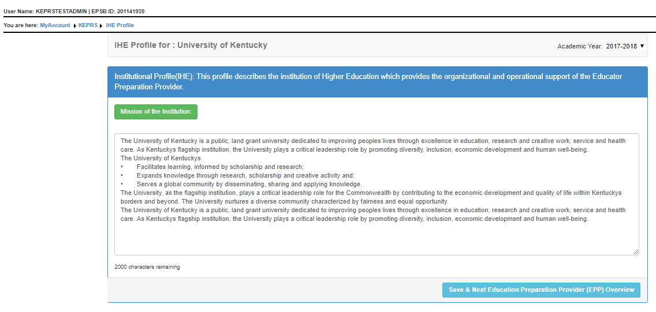
KEPRS IHE Profile – Academic Year
Academic Year is selected and the responses are saved under the specific years you have selected. In this example - 2017-2018

Slide 4
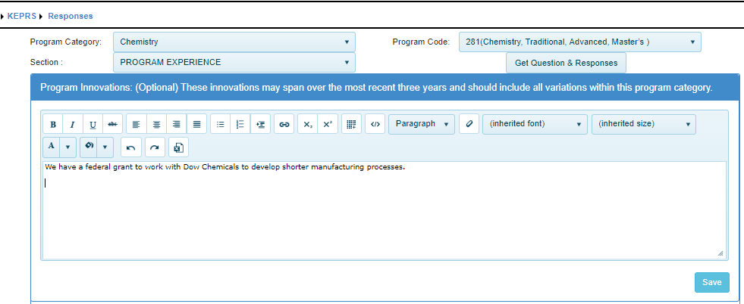
KEPRS Responses – Academic Year
Academic Year is not selected since all responses are saved under the current academic year. 2017-2018.
Sept 1, 2018 KEPRS will copy all responses into the 2018-2019 academic year.

Slide 5
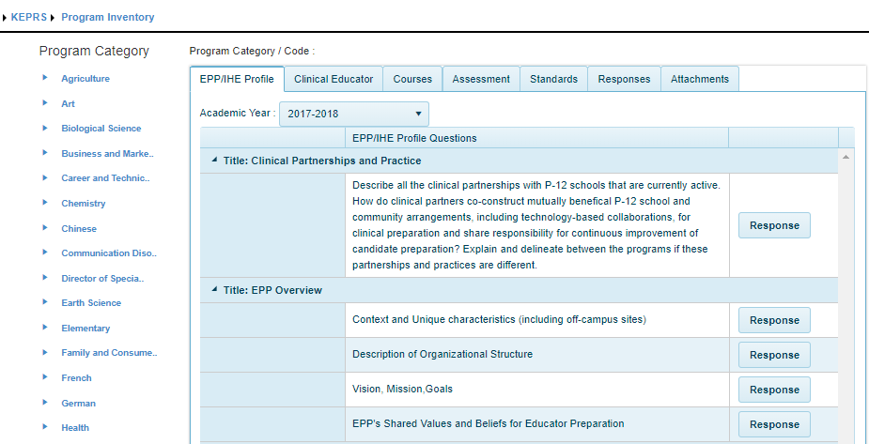
KEPRS Inventory View – Academic Year
When using the EPP/IHE Profile tab, you will select the academic year before viewing each of the responses. This allows program review members to look back at prior years narratives.

Slide 6
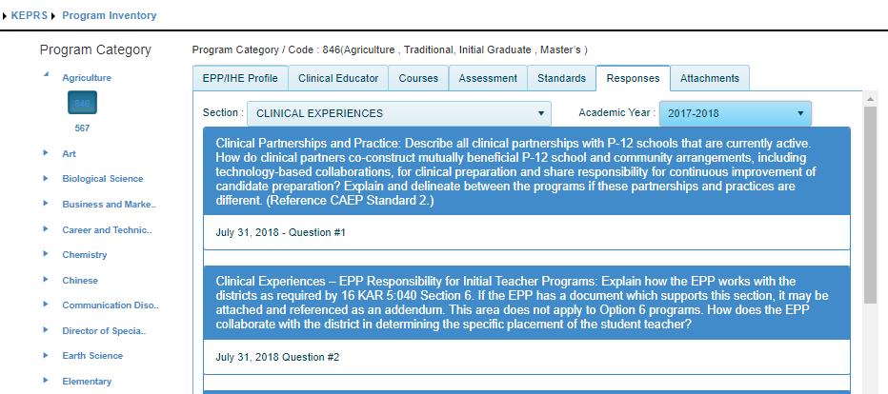
KEPRS Inventory View – Academic Year
When using the Responses tab, you will select the academic year before viewing each of the responses. This allows program review members to look back at prior years narratives.

Slide 7
KEPRS Standards for course alignment
We have added new set of standards to the selection for course alignment.
The new ACEP 2018 Elementary Teacher standards are now available.

