Slide 1
KEPRS Updates and Questions July 9th, 2018

Slide 2
Kentucky Educator Preparation Review System
Updates and New Functions:
What’s New – Updated Technical Guide 7-6-2018
IHE Profile – No more “Jump to Section”
Program Inventory – IHE Profile view
Permissions
Attach Supporting Documents
Courses – grid view
Questions:

Slide 3
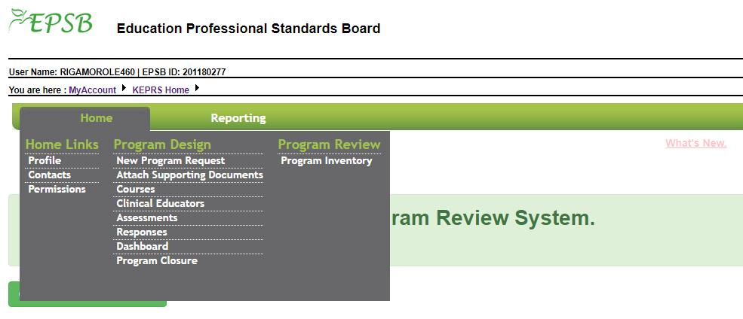
KEPRS EPP Landing page

Slide 4
KEPRS Technical Guide – July 6th 2018

Slide 5
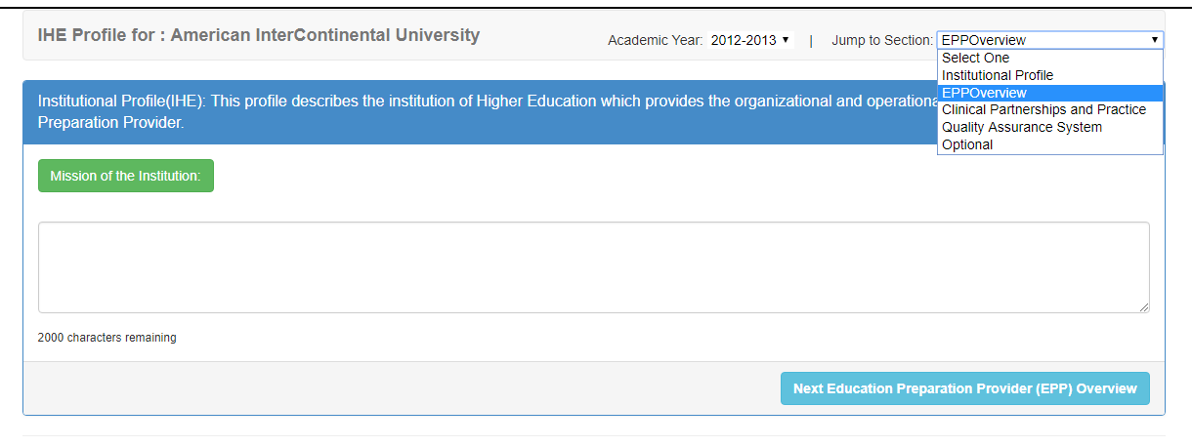
KEPRS IHE Profile
Remember to check Academic Year (default is current year)
We plan to remove “Jump to Section”

Slide 6
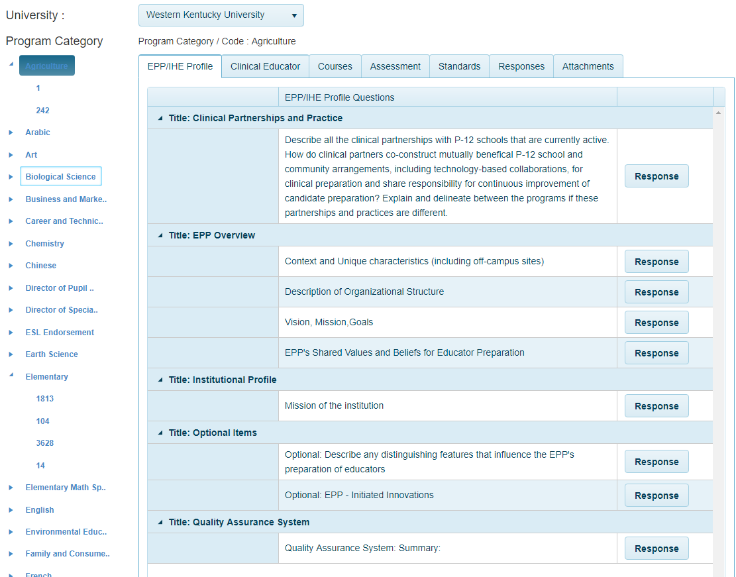
KEPRS Program Inventory – IHE Profile
IHE Profile is much shorter now as we moved the clinical experiences to the program responses module.

Slide 7
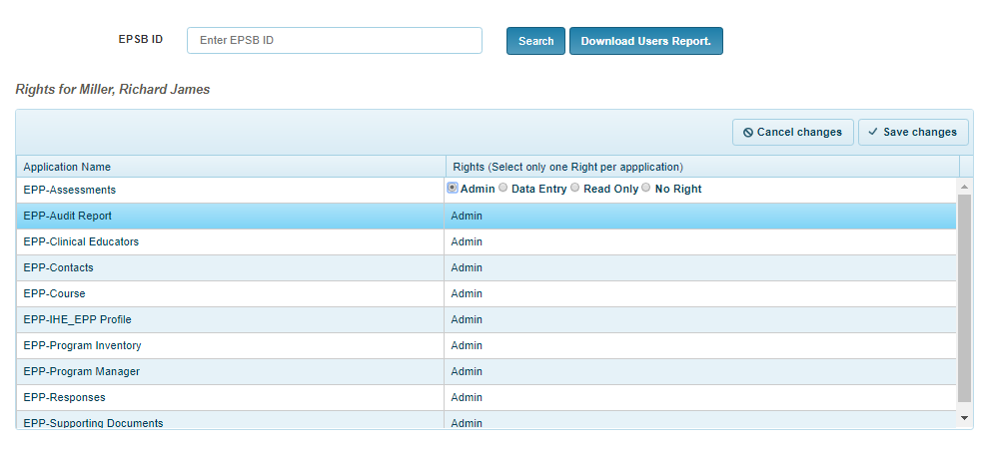
KEPRS Permissions
Each EPP has a designated IHE Security Admin (one or more)
Each module has rights which the EPP Security Admin controls
You can download a report of all users and rights

Slide 8
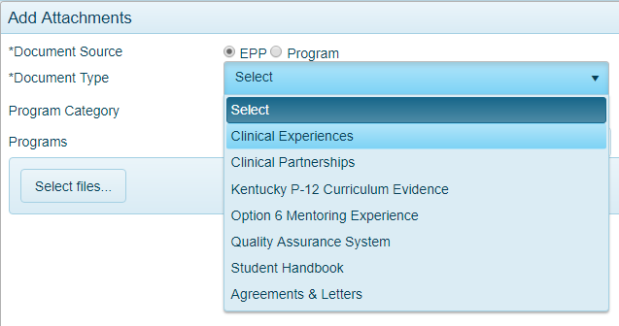
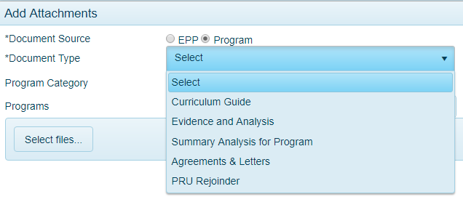
KEPRS Attach Supporting Documents
We have added “Agreements & Letters” to the document types
Examples: Dean’s Letter, Memorandum of understanding, etc…..

Slide 9
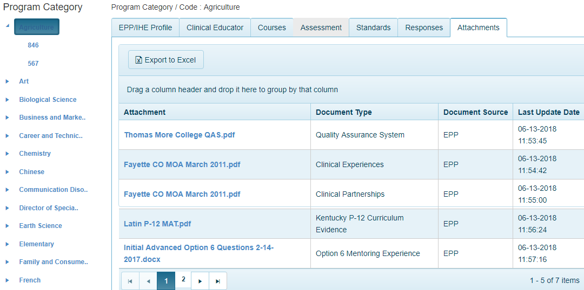
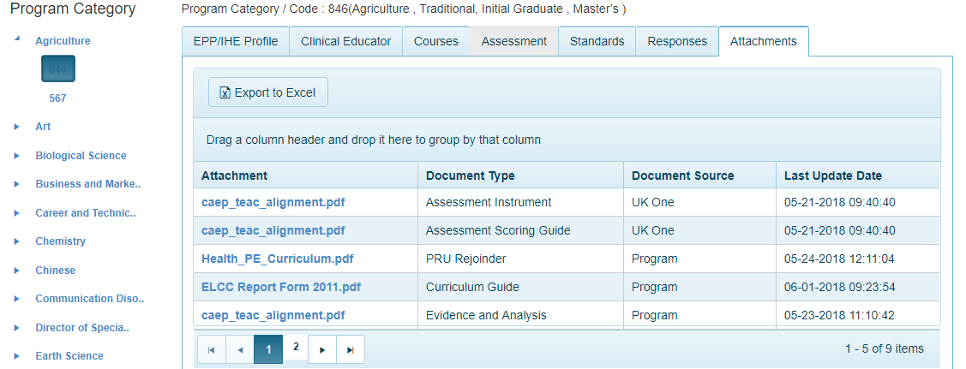
KEPRS Inventory View (EPP vs Program Code)
We have added “Agreements & Letters” to the document types
Examples: Dean’s Letter, Memorandum of understanding, etc…..

Slide 10
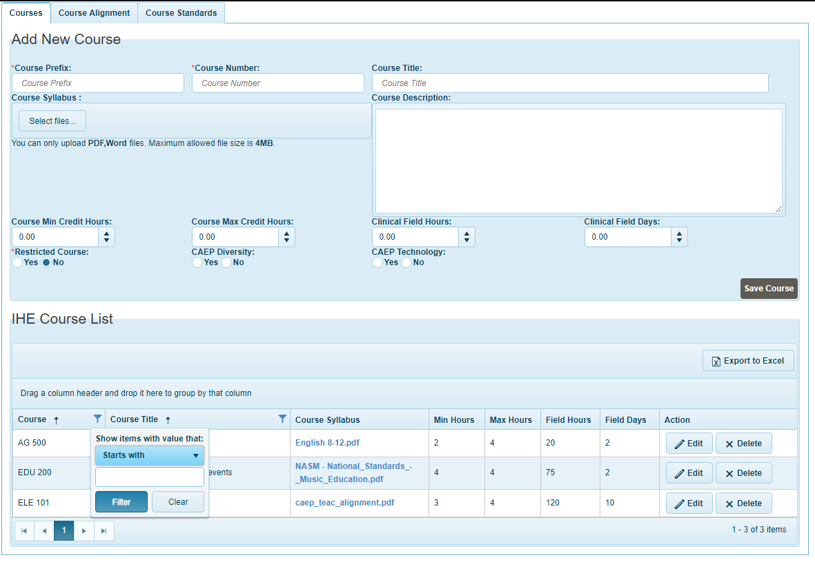
KEPRS Courses
We have added defaults and features to the courses grid view
The list will be pre-sorted by Course in ascending order
The Course field can be filtered by “Starts with” or “Is equal to”

