Slide 1
KEPRS Updates and Questions June 4th, 2018

Slide 2
Kentucky Educator Preparation Review System
Updates and New Functions:
What’s New
Program Closure
New Audit reports
Inventory View
Questions:
Why does KEPRS reject my Assessment name?
Why does KEPRS only allow one selection in the Assessment areas?

Slide 3
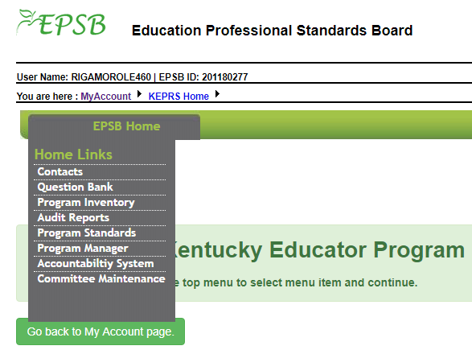
KEPRS EPSB Landing Page

Slide 4
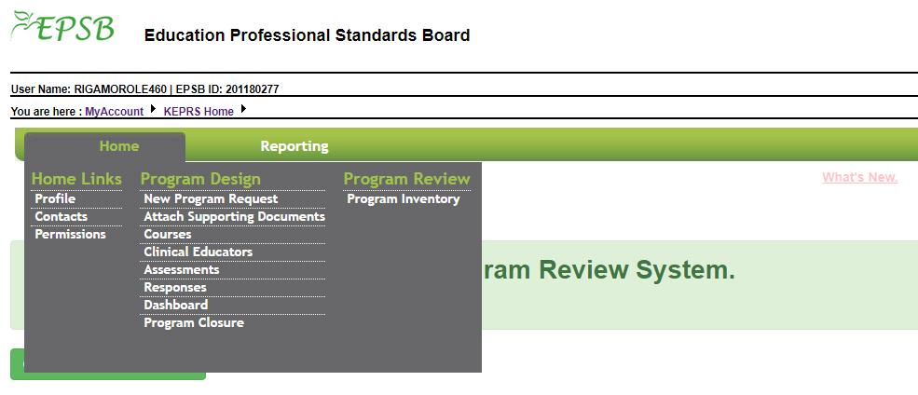
KEPRS EPP Landing page

Slide 6
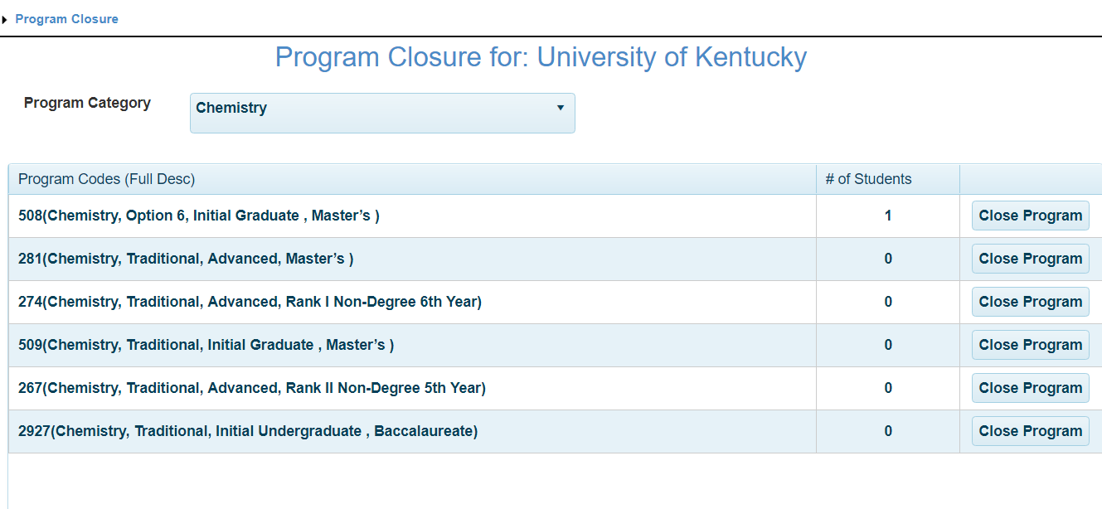
Program Closure

Slide 7
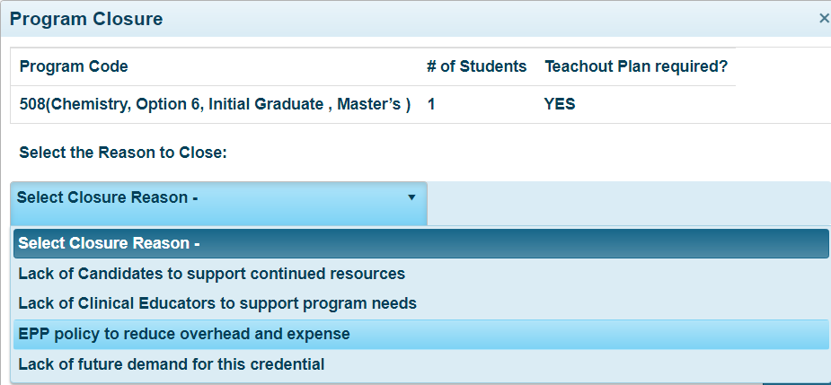
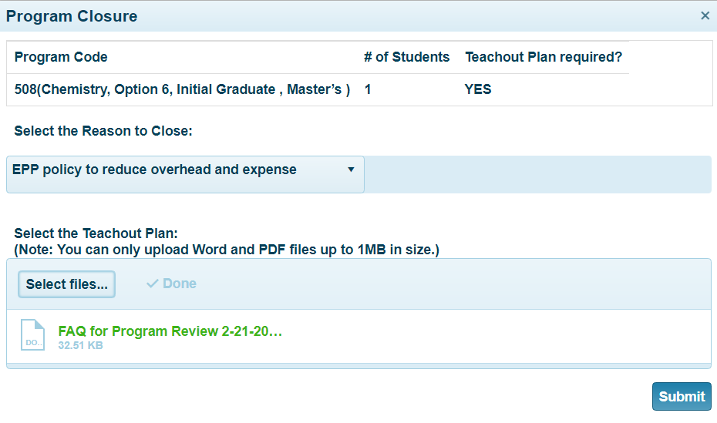
Program Closure

Slide 8
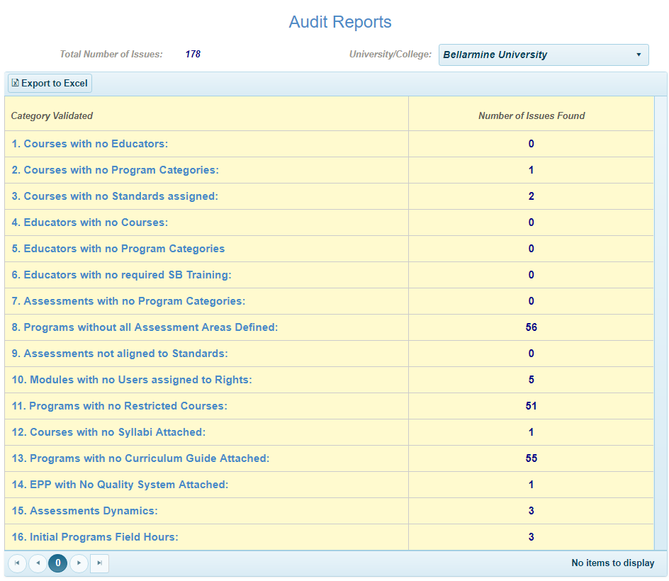
New Audit Reports

Slide 9
New Audit Reports

Slide 10
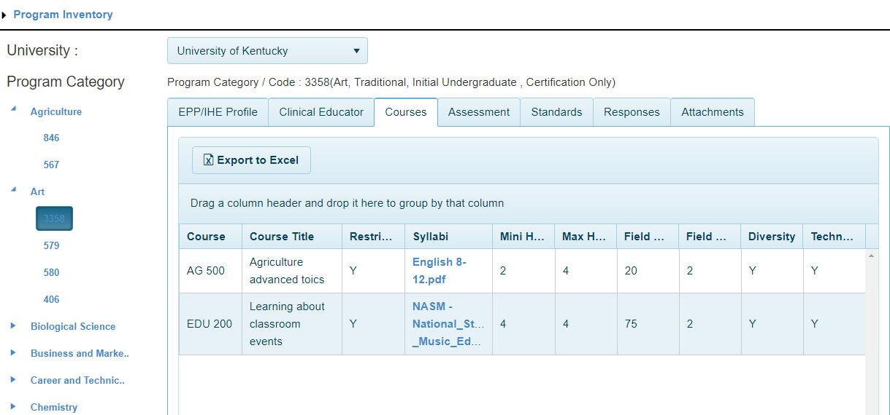
Inventory View

Slide 11
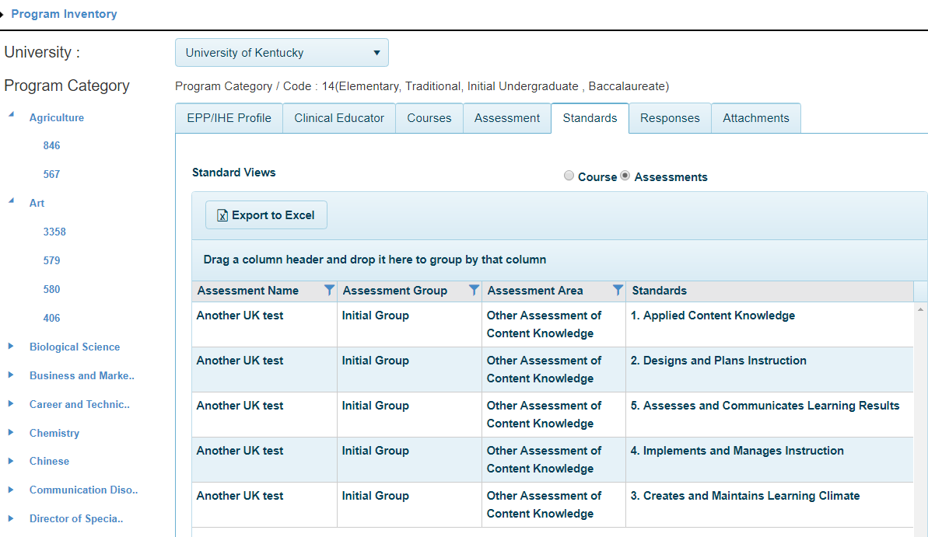
Inventory View

