Slide 1
KFETS Kentucky Field Experience Tracking System
Institution

Slide 2
Login to EPSB
The preferred browser for KFETS is IE 9 and above
Create an EPSB account (if you do not already have one)
An EPSB account is required for access to KFETS
Go to www.epsb.ky.gov
Click “EPSB Account” at the top of the page to be redirected to the EPSB Web Portal
Click “Create an Account Here”
Enter required information
Access to KFETS should be requested by the Chair/Unit Head to Brandon Harrod- Brandon.Harrod@ky.gov
An email will be sent out to Chairs/Unit Heads for the initial request of permissions to access KFETS
Additional requests may be made by Chairs/Unit Heads at any time by sending an email to Brandon Harrod

Slide 3
Log in to EPSB
The preferred browser for KFETS is IE 9 and above
Go to www.epsb.ky.gov
Click Here for log in

Slide 4
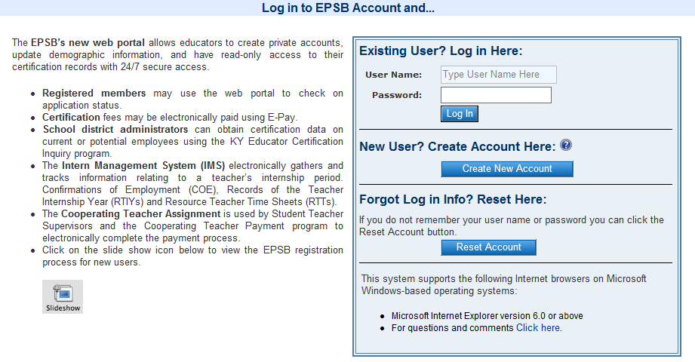
If you have an EPSB account, enter your username and password under “Existing User? Log in Here” If you do not have an EPSB account, click “Create New Account” under “New User? Create Account Here” If you have an account but forgot your log in information, click “Reset Account” under “Forgot Log in Info? Reset Here”

Slide 5
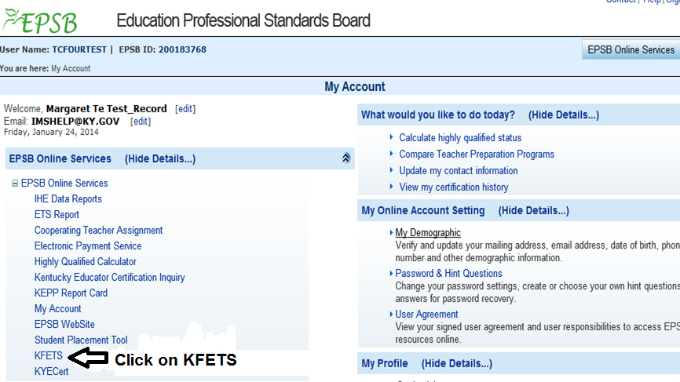
Click on KFETS under EPSB Online Services
If you do not have the KFETS option, please contact Lauren.Graves@ky.gov to request rights for your institution

Slide 6
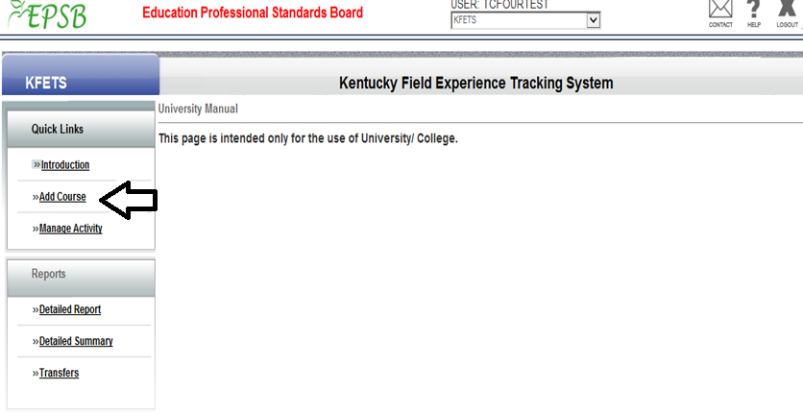
Add Course
Click on the “Add Course” link to begin adding or uploading course information. Before a candidate can start recording activities, each university/college must create a catalog of courses within KFETS. Courses may be added manually (individually) or through batch load.

Slide 7
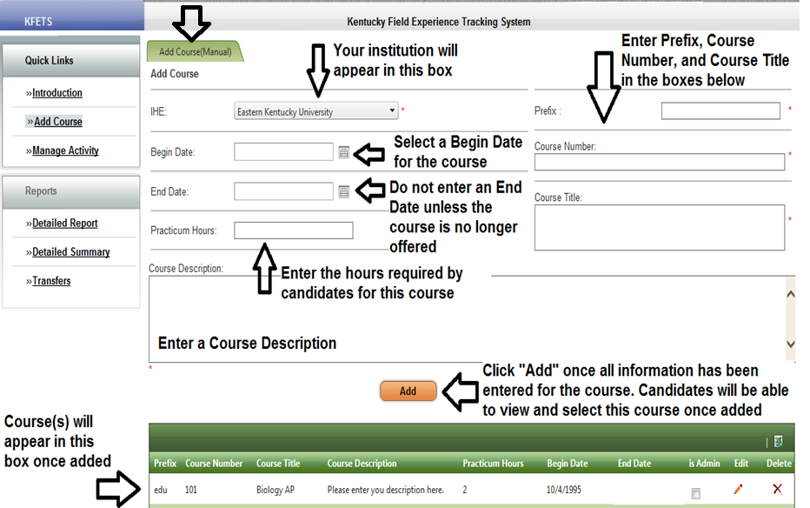
Add Course
Manual

Slide 8
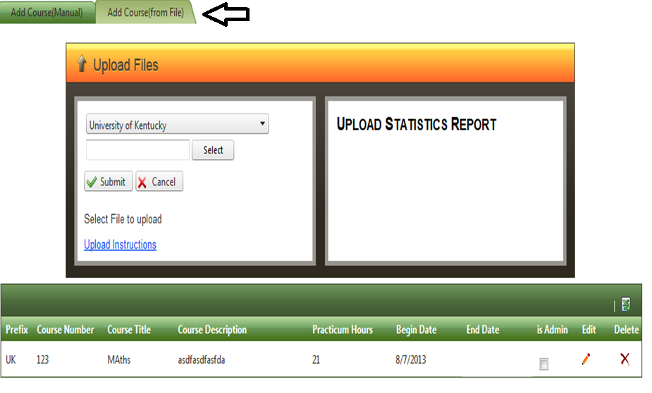
Add Course
Batch Load

Slide 9
Add Course
Batch Load
An “End Date” should not be included unless the course is no longer offered.

Slide 10
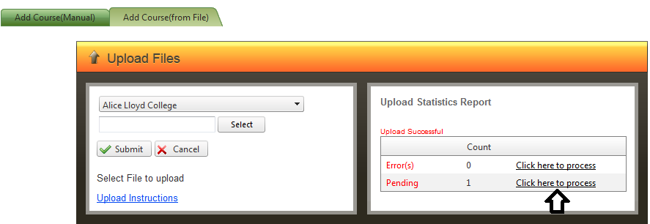

Slide 11
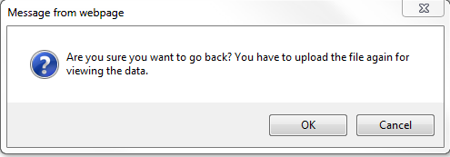
Click “OK” to go back to the Batch Load Screen

Slide 12
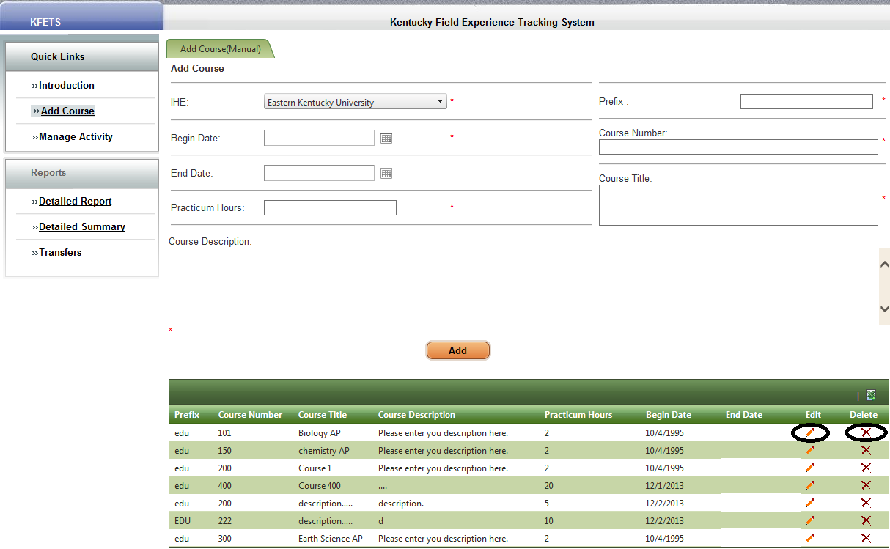
Add Course
Edit/Delete
Courses may be edited or deleted by clicking the appropriate function button. If a course is deleted, all attached data will be deleted.
If you want to close a course, click “Edit”, enter an “End Date”, and click the check mark. The course will no longer be available for students to enter data.

Slide 13
Once a course is added, it will remain an option for candidates until an end date is entered. An end date should be entered only when the course is no longer available.

Slide 14
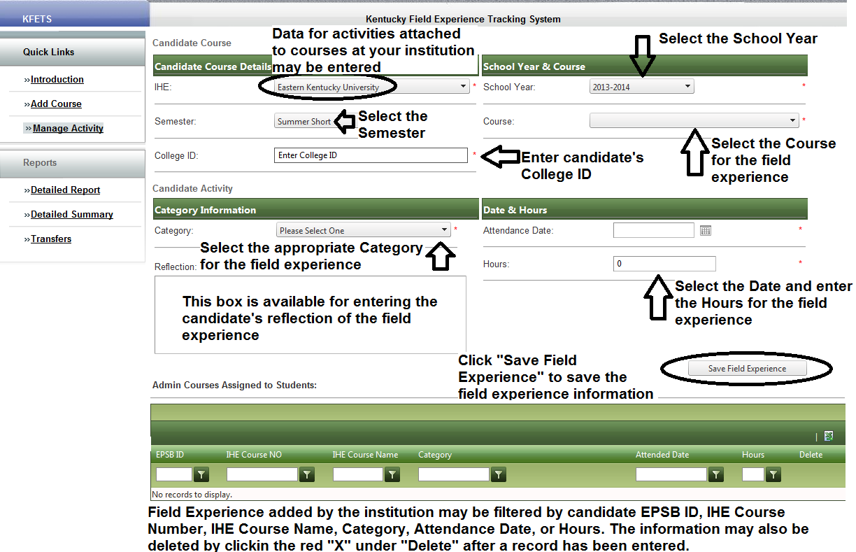
Manage Activity
This section is available for adding summary hours for candidates and should be used sparingly. Candidates are responsible for reporting their hours, but this section may be used by institutions if necessary.

Slide 15
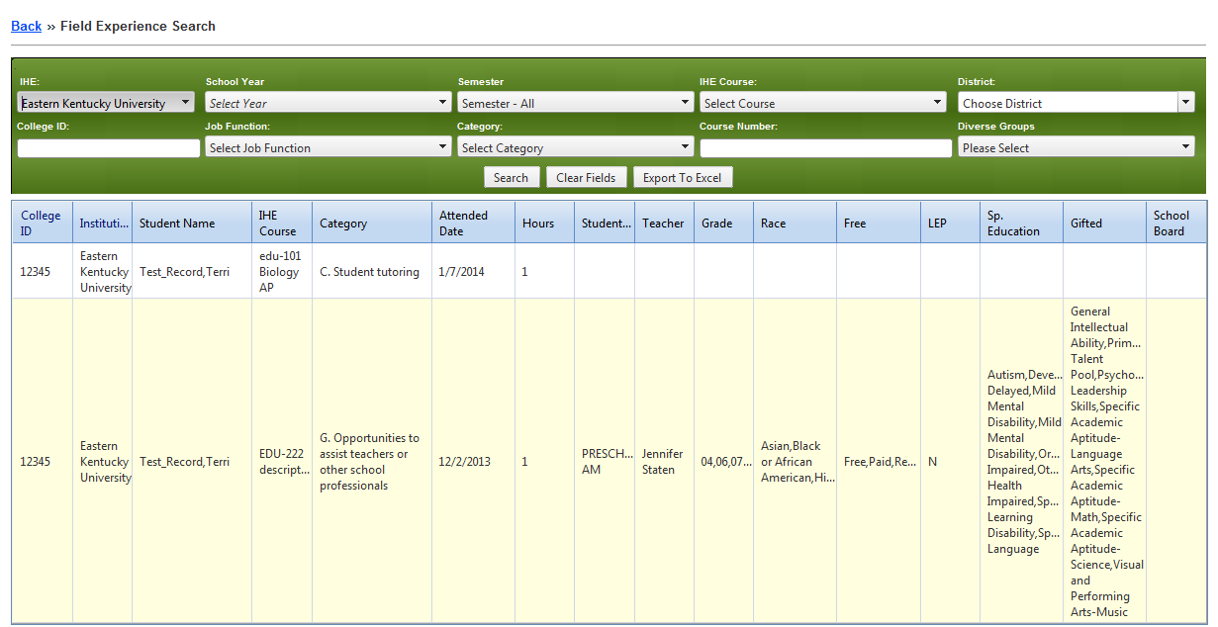
Detailed Report
Enables IHE to filter reported field experiences based on School Year, Semester, IHE Course, District, College ID, Job Function(of school personnel), Category, Course Number, or Diverse Groups. This data may be exported to excel by clicking “Export to Excel”.

Slide 16
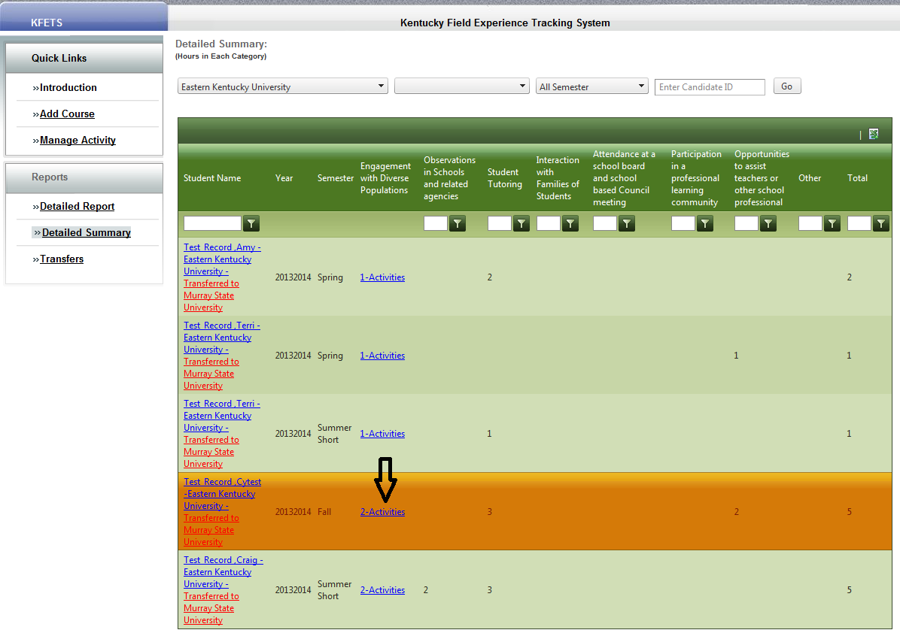
Detailed Summary
Click on the activities under “Engagement with Diverse Populations” to view details about the recorded hours. This shows the breakdown of the hour(s) for that one activity.

Slide 17
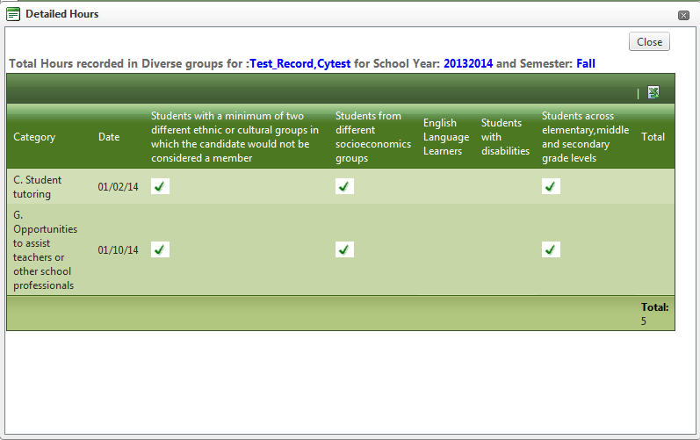
Detailed Summary
This box shows the breakdown of the diverse group information for the selected number of activities and hours.
The checked boxes indicate the interactions with Diverse Groups within that field experience.

Slide 18
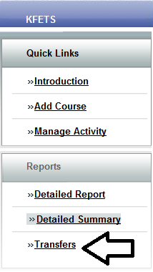
Transfers
Initiate transfer
Field experience hours may be transferred from one institution to another. A candidate must request his/her hours be transferred from institution “A” to institution “B”. Click “Transfers” to begin.

Slide 19
Transfers
Institution “A” will initiate the transfer by clicking “Make a Transfer/View Transfer History.

Slide 20
Transfers
Transferred hours may be accepted or denied.

Slide 21
Transfers
Initiated Transfers from institution “A” to institution “B”

Slide 22
Transfers
Status of transferred field experience hours from institution “A” to institution “B”
A Status of Pending will remain until institution “B” accepts or denies the transferred field experience hours.

Slide 23
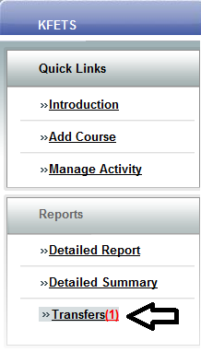
Transfers
View transfer(s)
Once institution “A” initiates a transfer, institution “B” will be notified with a red number next to “Transfer” after logging in to KFETS.
The red number represents the number of initiated transfers for approval/denial.

Slide 24
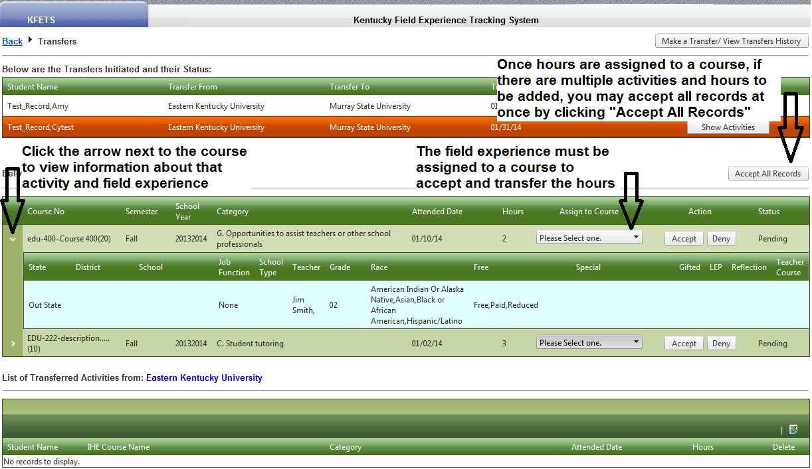
Transfers
Accept/deny transfer(s)
Each activity will begin with a Status of “Pending”. Once an activity is accepted, the activity will appear in the “List of Transferred Activities”. Denied activities will be deleted from the list.

Slide 25
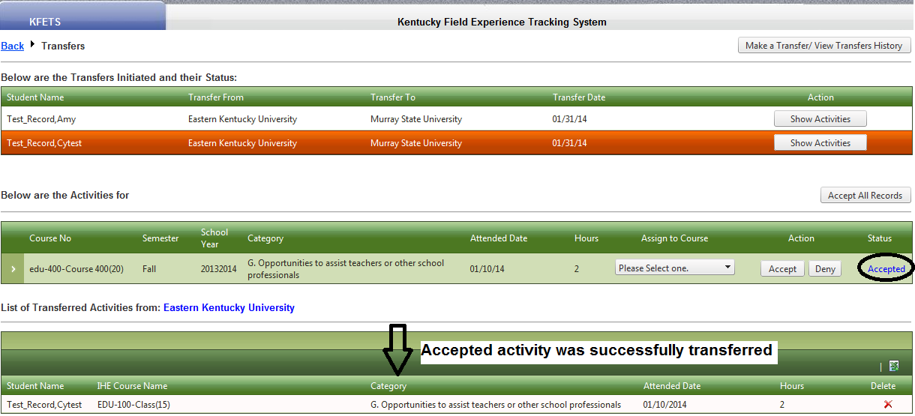
Transfers
Accepted
Accepted activities will be added to the “List of Transferred Activities” box and have a Status of “Accepted”. If an activity needs to be deleted, click the red “X” under “Delete”. All information attached to that activity will be deleted.

Slide 26
Exporting Data
Data may be exported to Excel from each of the following sections
Add Course: Export your uploaded courses to Excel by clicking the Excel icon
Manage Activity: Export data input by the IHE on behalf of candidates to Excel by clicking the Excel icon
Detailed Report: Click the Export to Excel button
Detailed Summary: Export field experience activity data to Excel by clicking the Excel icon
Transfers: Export List of Transferred Activities to Excel by clicking the Excel icon

