Slide 1
KFETS Kentucky Field Experience Tracking System
Candidate

Slide 2
Log in to EPSB
The preferred browser for KFETS is IE 9 and above
Go to www.epsb.ky.gov
Click Here for log in

Slide 3
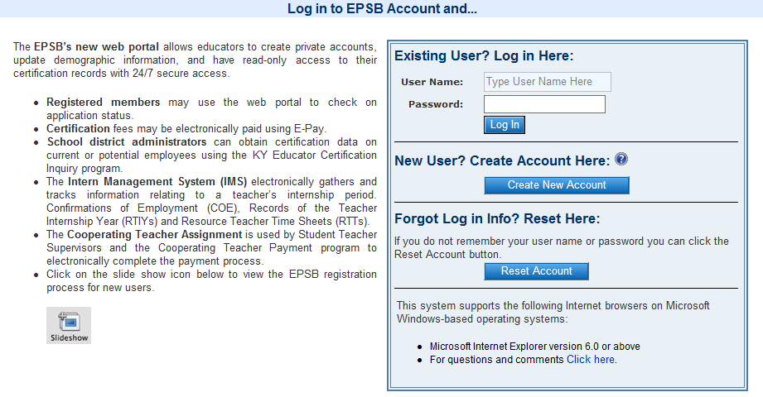
If you have an EPSB account, enter your username and password under “Existing User? Log in Here” If you do not have an EPSB account, click “Create New Account” under “New User? Create Account Here” If you have an account but forgot your log in information, click “Reset Account” under “Forgot Log in Info? Reset Here”

Slide 4
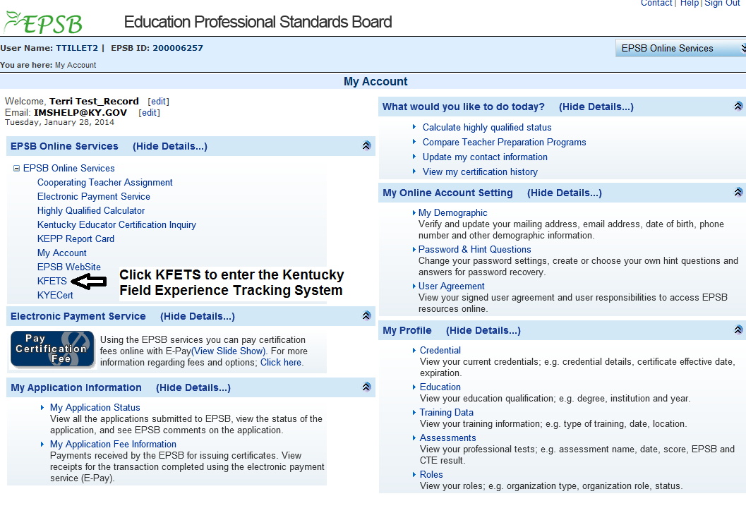
KFETS link

Slide 5
KFETS
The preferred browser for KFETS is IE 9 and above. Other browsers may have formatting issues.
(*) indicates the field is required.
Questions regarding field experience entries should be sent to your institution/Field Experience Coordinator.

Slide 6
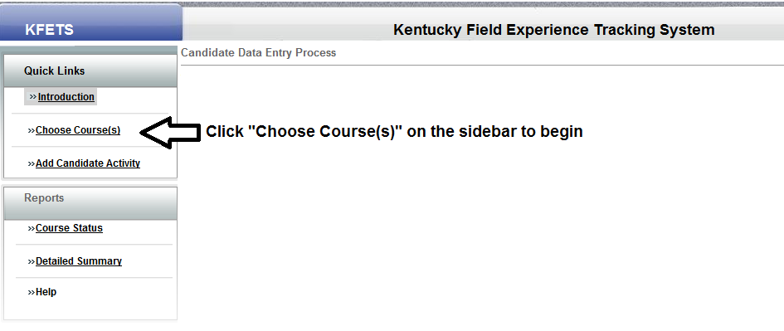
Choose Course(s)

Slide 7
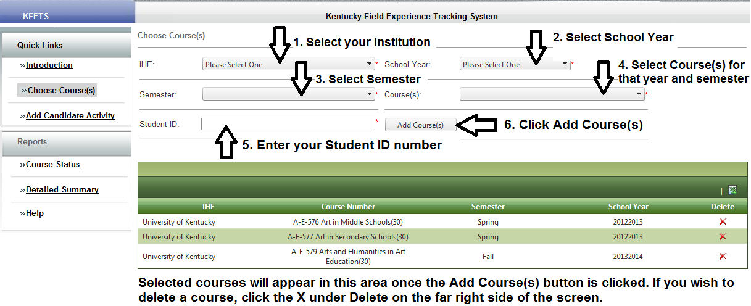
Choose Course(s)
Deleting a course will delete all data associated with student activities, experiences, and hours.

Slide 8
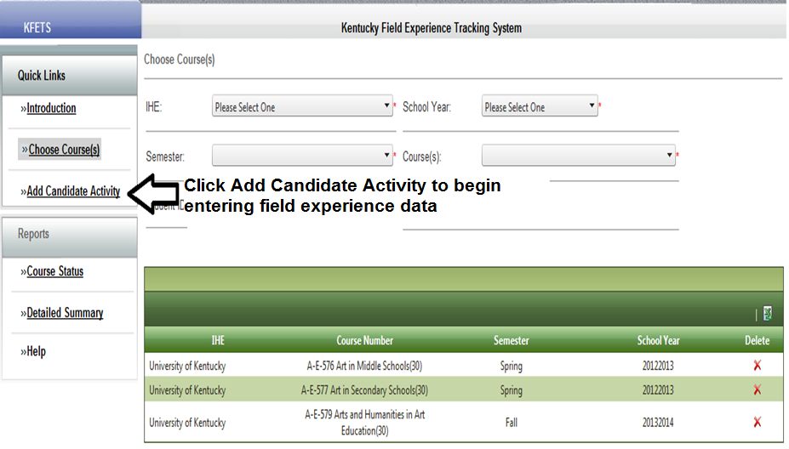
Add Candidate Activity

Slide 9
Add Candidate Activity
“Not Started” will show under Data Entry Hours until field experience data has been entered for that course; “In Progress” will show once field experience is entered for that course.

Slide 10
Disclaimer

Slide 11
Categories
B. Observations in schools and related agencies (If a public, Kentucky school is selected, data for Diverse Group Information will be populated by Infinite Campus data)
C. Student tutoring
D. Interaction with families of students
E. Attendance at a school board and school-based council meeting
F. Participation in a school-based professional learning community
G. Opportunities to assist teachers or other school professionals (if a public, Kentucky school is selected, data for Diverse Group Information will be populated by Infinite Campus data)
H. Other (when selected for overall category, or within categories, all information must be entered manually)
http://www.lrc.ky.gov/kar/016/005/040.htm

Slide 12
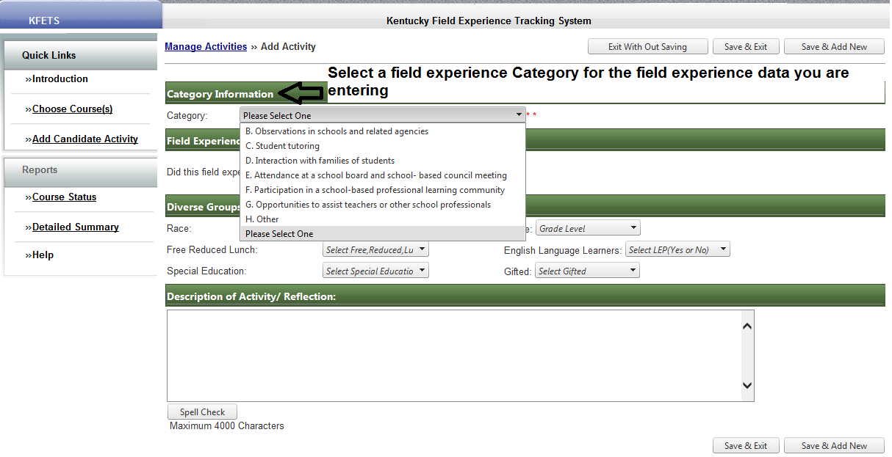
Category Information
If you are uncertain about which category to choose, contact your Field Experience Coordinator or institution.

Slide 13
B. Observations in schools and related agencies
Schools
If observations in a Kentucky public school is selected, data from Infinite Campus will populate the Diverse Groups Information. If data is not available, manually enter the data in the Diverse Groups Information section. If the teacher/course does not appear, select “Other” at the bottom of the teacher name list to manually enter data.
If observations in a school is selected and either the experience was out-of-state and/or in a private school, data for Diverse Groups Information must be manually entered.
Related Agencies
If you select observations in related agencies, manually entering the data is required.

Slide 14
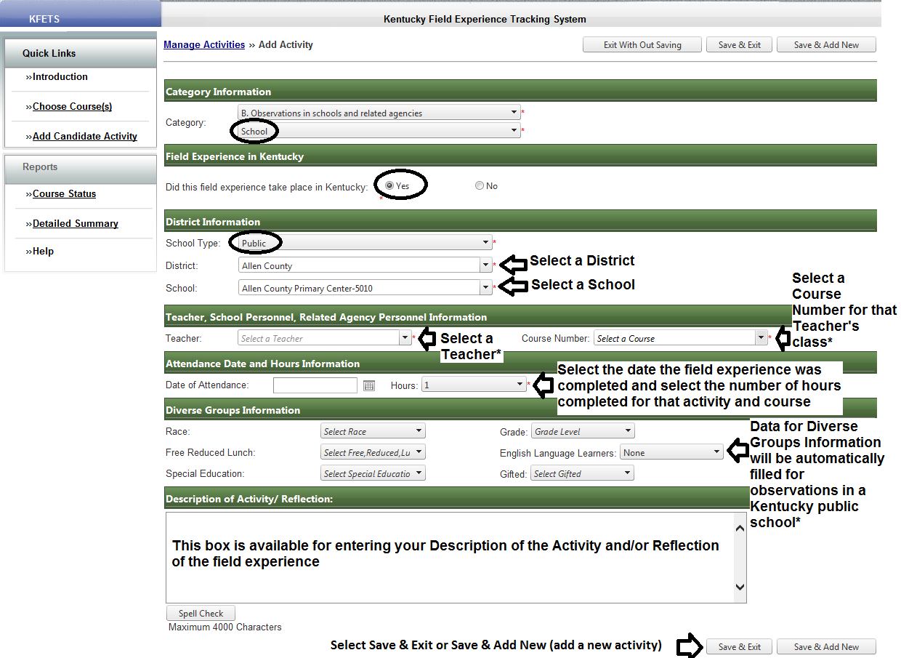
B. Observations in schools
School/Kentucky/Public
*If a teacher or course does not appear in the dropdown list, data for Diverse Groups Information will not appear. Choose “Other” at the bottom of the list of Teachers to manually enter data.

Slide 15
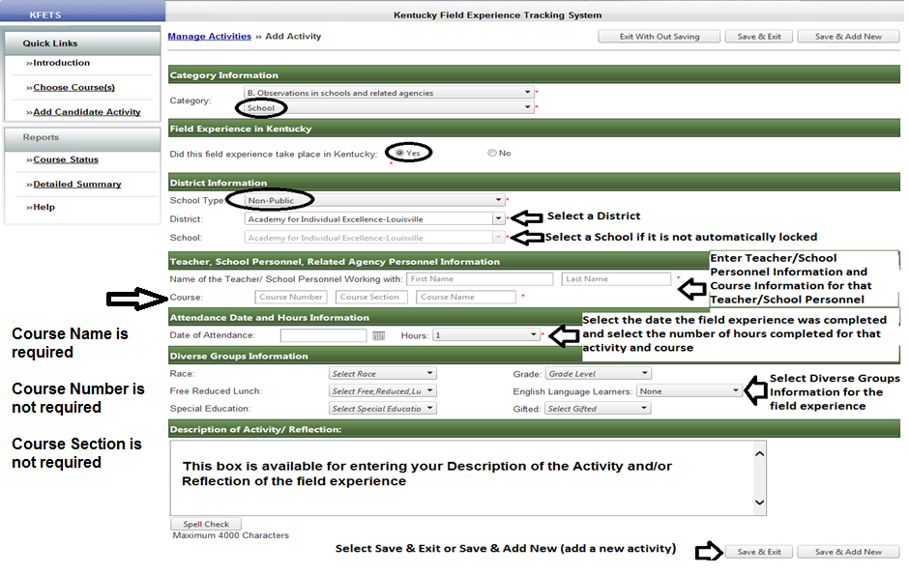
B. Observations in schools
School/Kentucky/Non-Public

Slide 16
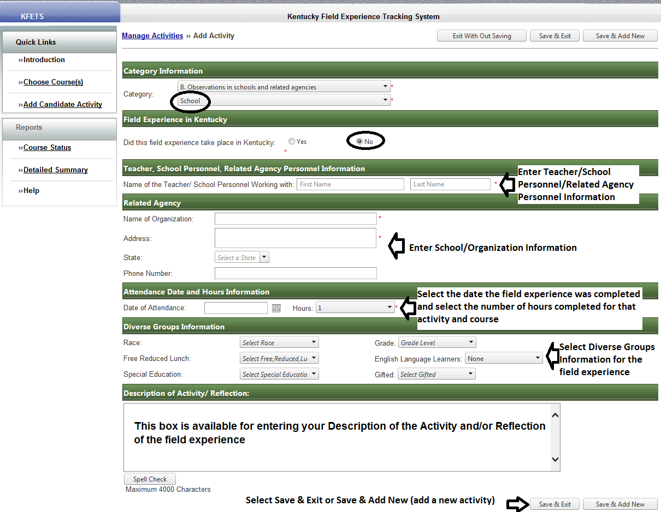
B. Observations in schools
School/Out-of-state

Slide 17
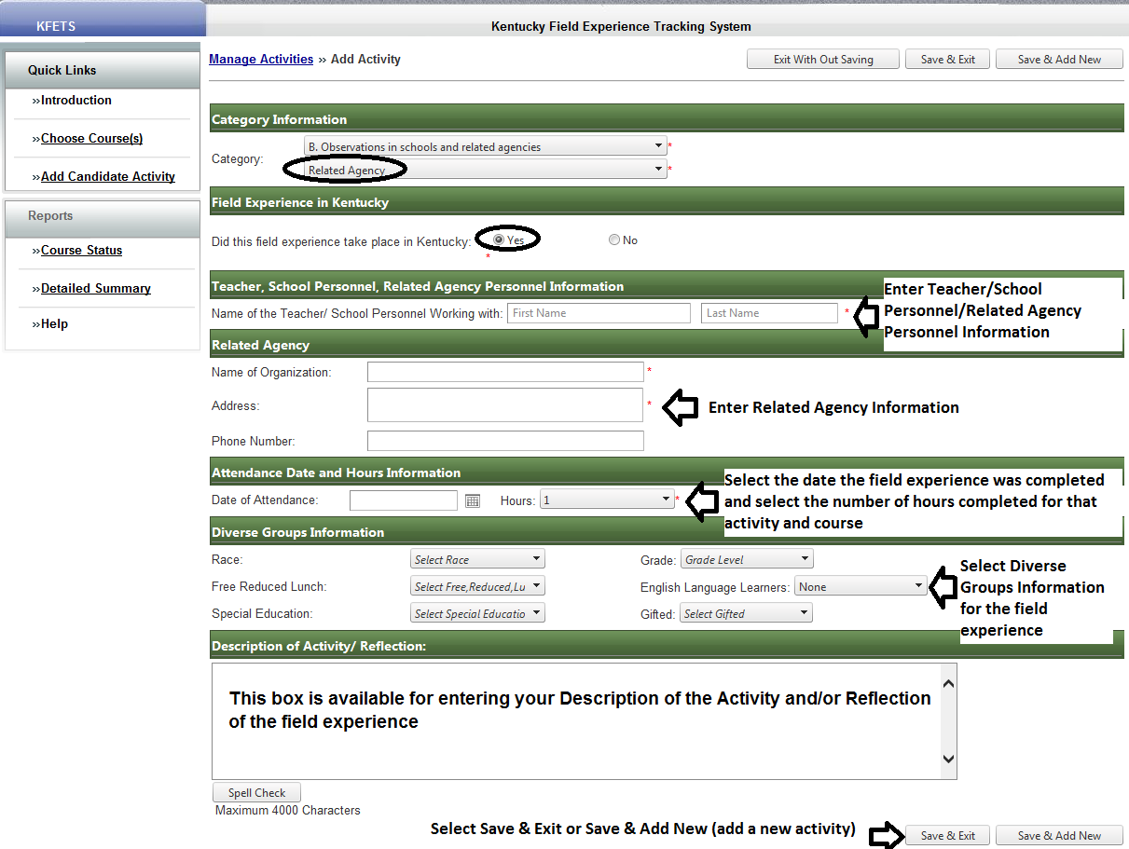
B. Observations in related agencies
Related Agency/ Kentucky

Slide 18
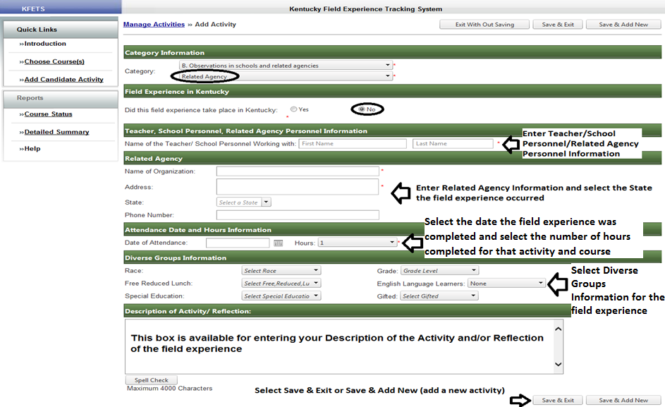
B. Observations in related agencies
Related Agency/Out-of-state

Slide 19
C. Student tutoring
Did this field experience take place in Kentucky? Yes and Public or Non-Public
Select district information
Manually enter teacher, school personnel, or related agency personnel information
Select date and enter hour(s) of field experience
Manually select diverse groups information
Enter reflection
Select Save & Exit or Save & Add New
Did this field experience take place in Kentucky? No
Manually enter teacher, school personnel, related agency personnel information
Manually enter name of organization and related information
Select date and enter hour(s) of field experience
Manually select diverse groups information
Enter reflection
Select Save & Exit or Save & Add New
Other
Select “Other” if the student teaching occurred outside of a school
Manually enter required data

Slide 20
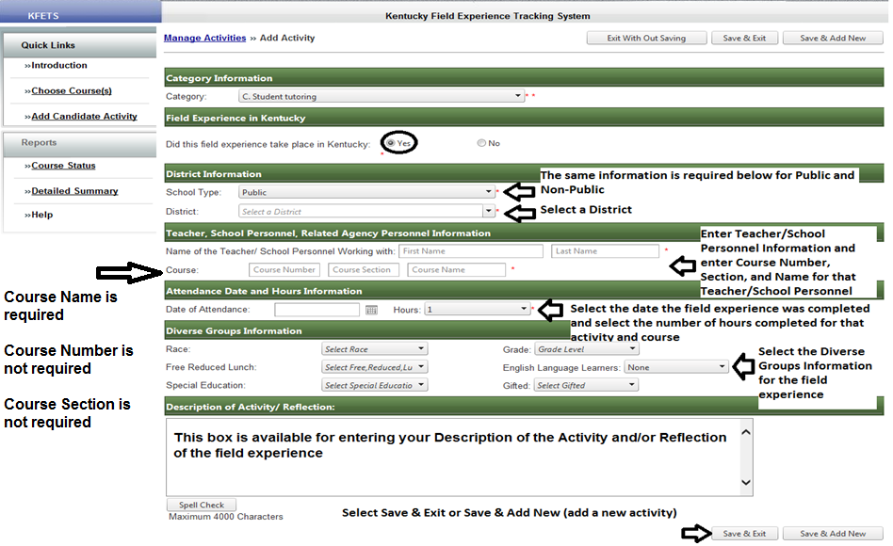
C. Student tutoring
Kentucky/Public or Non-Public

Slide 21
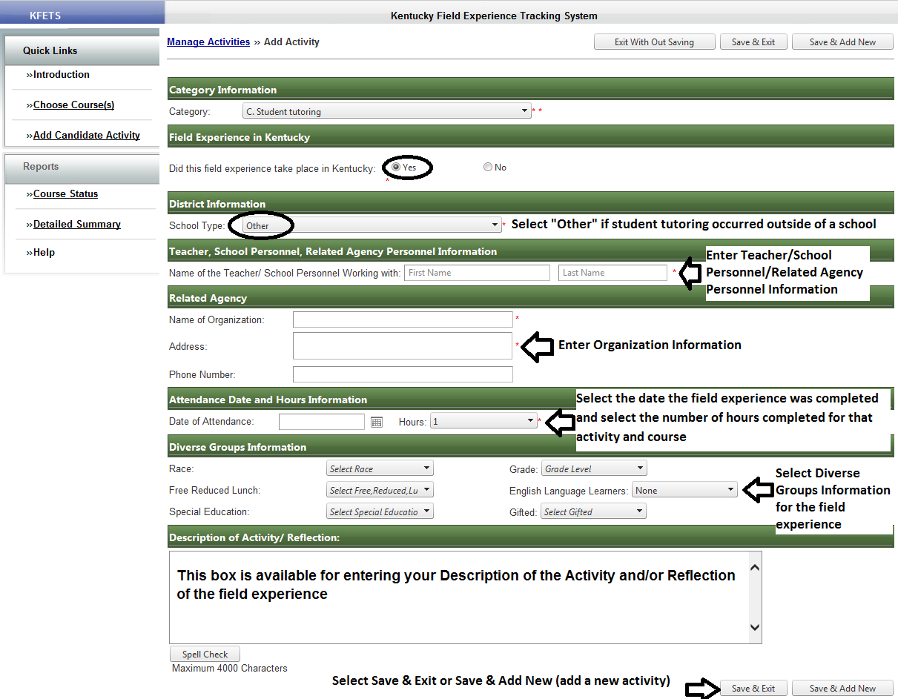
C. Student tutoring
Kentucky/Other

Slide 22
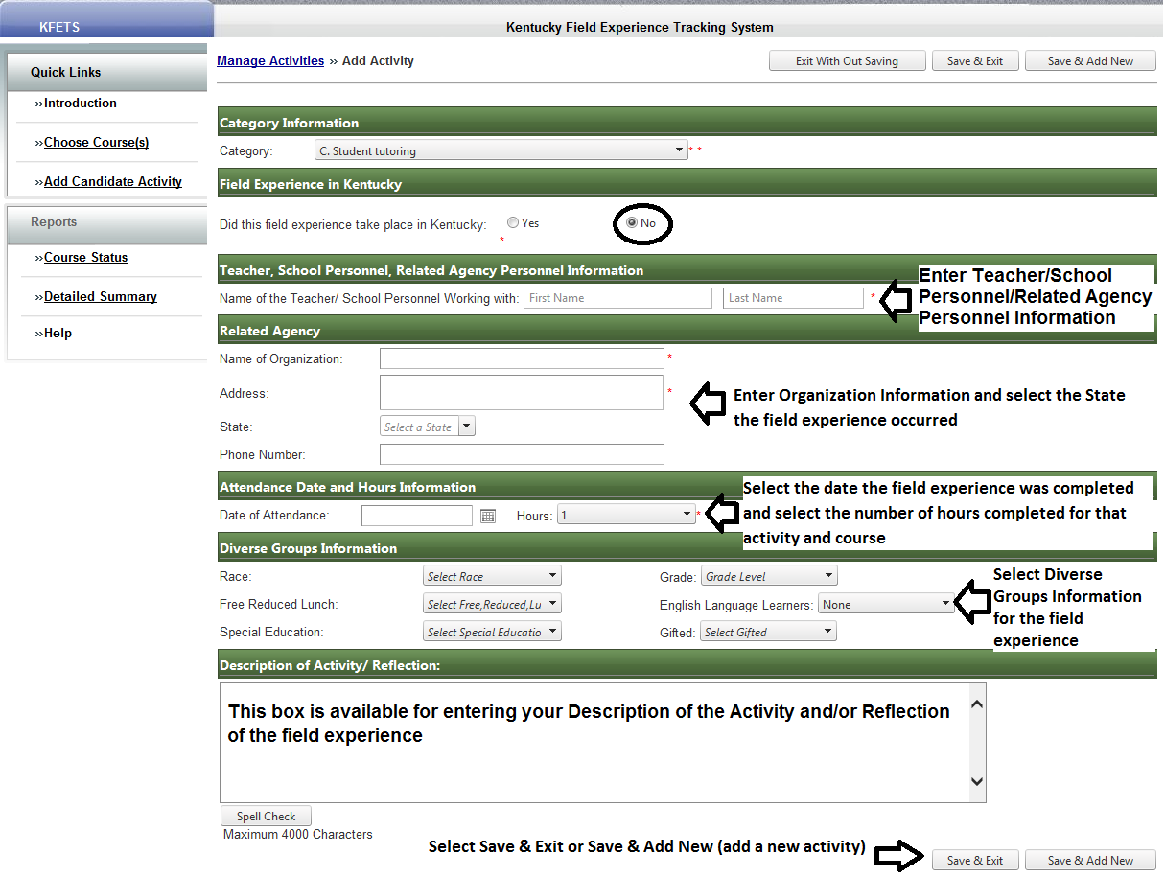
C. Student tutoring
Out-of-state

Slide 23
D. Interaction with families of students
Did this field experience take place in Kentucky? Yes and Public or Non-Public
Select district information
Manually enter teacher, school personnel, or related agency personnel information
Select date and enter hour(s) of field experience
Manually select diverse groups information
Enter reflection
Did this field experience take place in Kentucky? No
Manually enter teacher, school personnel, related agency personnel information
Manually enter name of organization and related information
Select date and enter hour(s) of field experience
Manually select diverse groups information
Enter reflection
Other
Select “Other” if the interaction with families of students occurred outside of a school
Manually enter required data

Slide 24
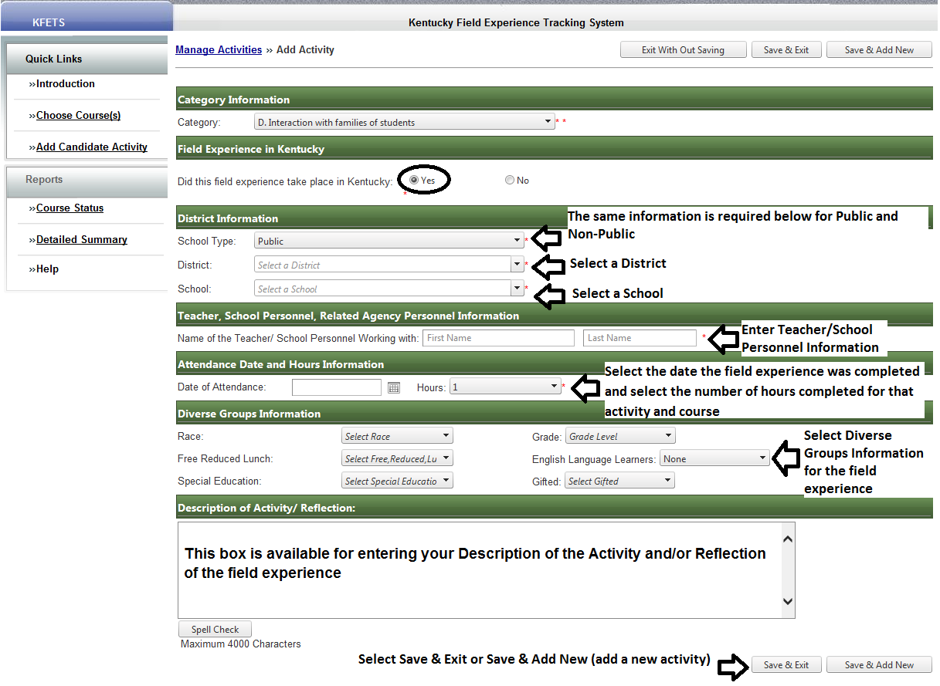
D. Interaction with families of students
Kentucky/Public and Non-Public

Slide 25
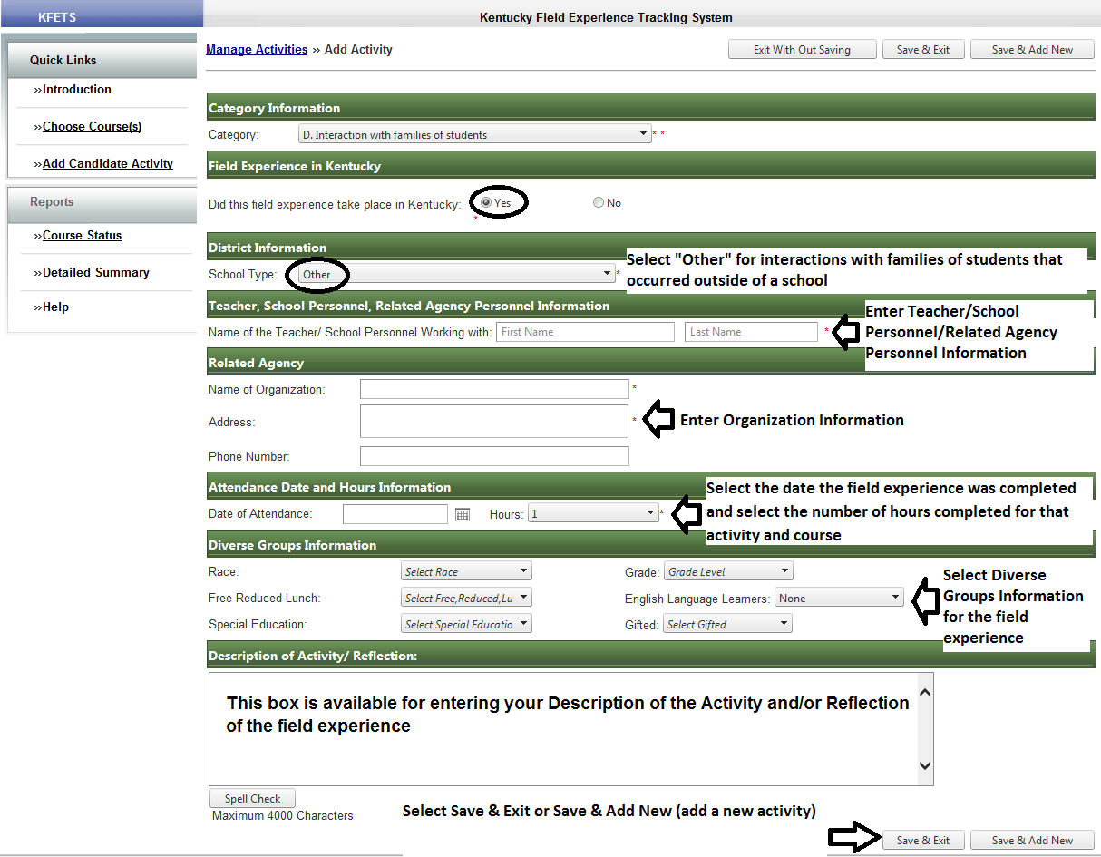
D. Interaction with families of students
Kentucky/Other

Slide 26
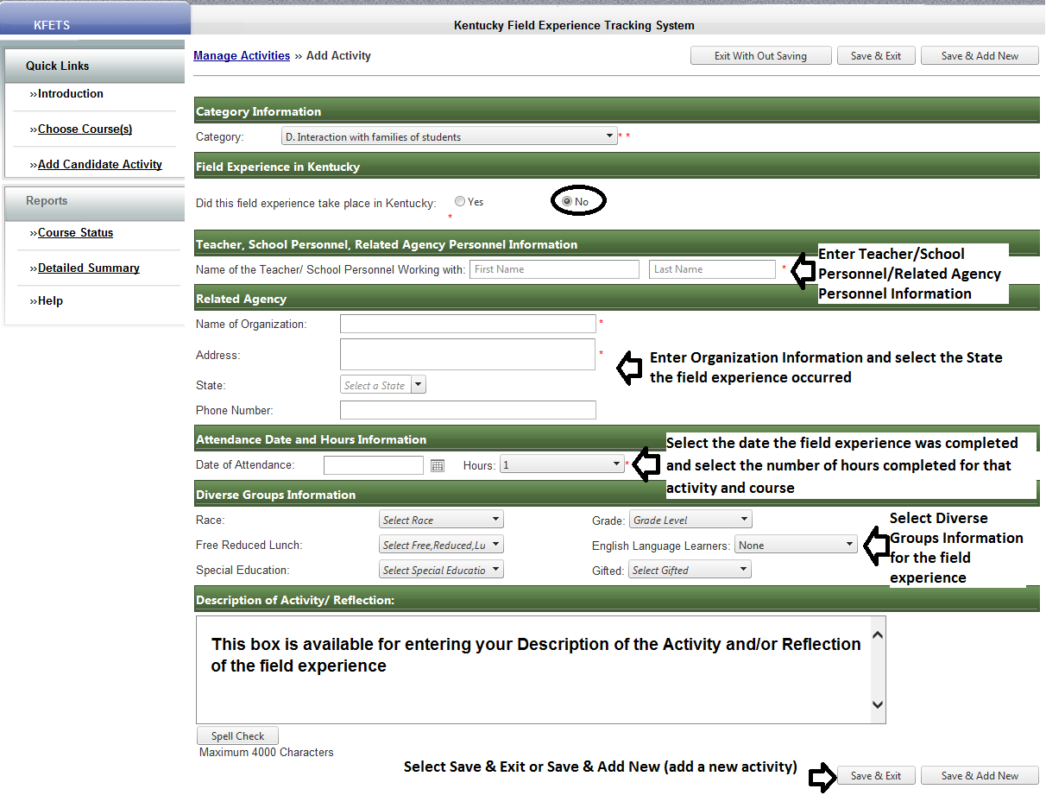
D. Interaction with families of students
Out-of-state

Slide 27
E. Attendance at a school board and school-based council meetings
Did this field experience take place in Kentucky? Yes and Public or Non-public
Select district information
Select the job function of the teacher/school personnel
Manually enter teacher or school personnel information
Select the type of meeting
Select date and enter hour(s) of field experience
Enter reflection
Did this field experience take place in Kentucky? No
Manually enter teacher or school personnel information
Manually enter name of organization and related information
Select the type of meeting
Select date and enter hour(s) of field experience
Enter reflection

Slide 28
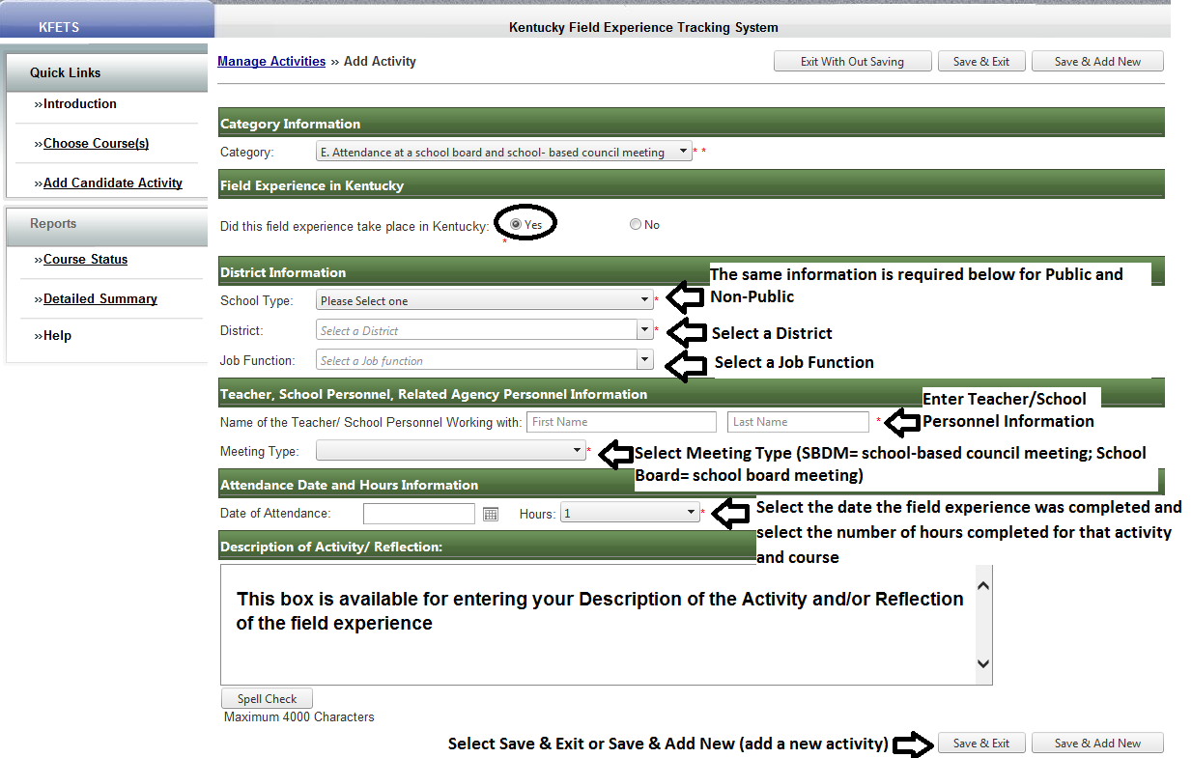
E. Attendance at a school board of school-based council meeting
Kentucky/Public and Non-Public

Slide 29
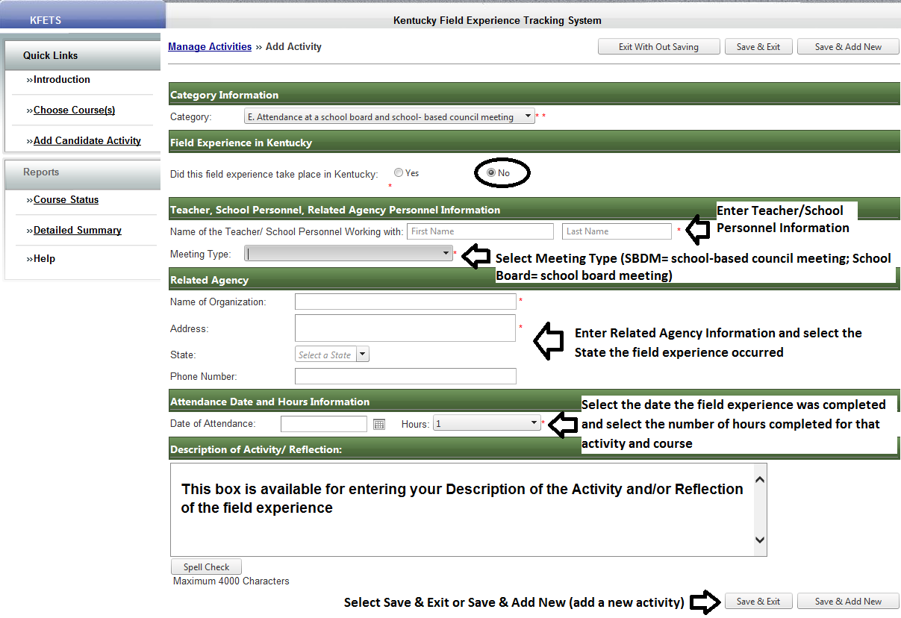
E. Attendance at a school board and school-based council meetings
Out-of-state

Slide 30
F. Participation in a school-based professional learning community
Did this field experience take place in KY? Yes and Public or Non-public
Select district information
Manually enter teacher or school personnel information
Select date and enter hour(s) of field experience
Enter reflection
Did this field experience take place in KY? No
Manually enter teacher or school personnel information
Manually enter name of organization and related information
Select date and enter hour(s) of field experience
Enter reflection

Slide 31
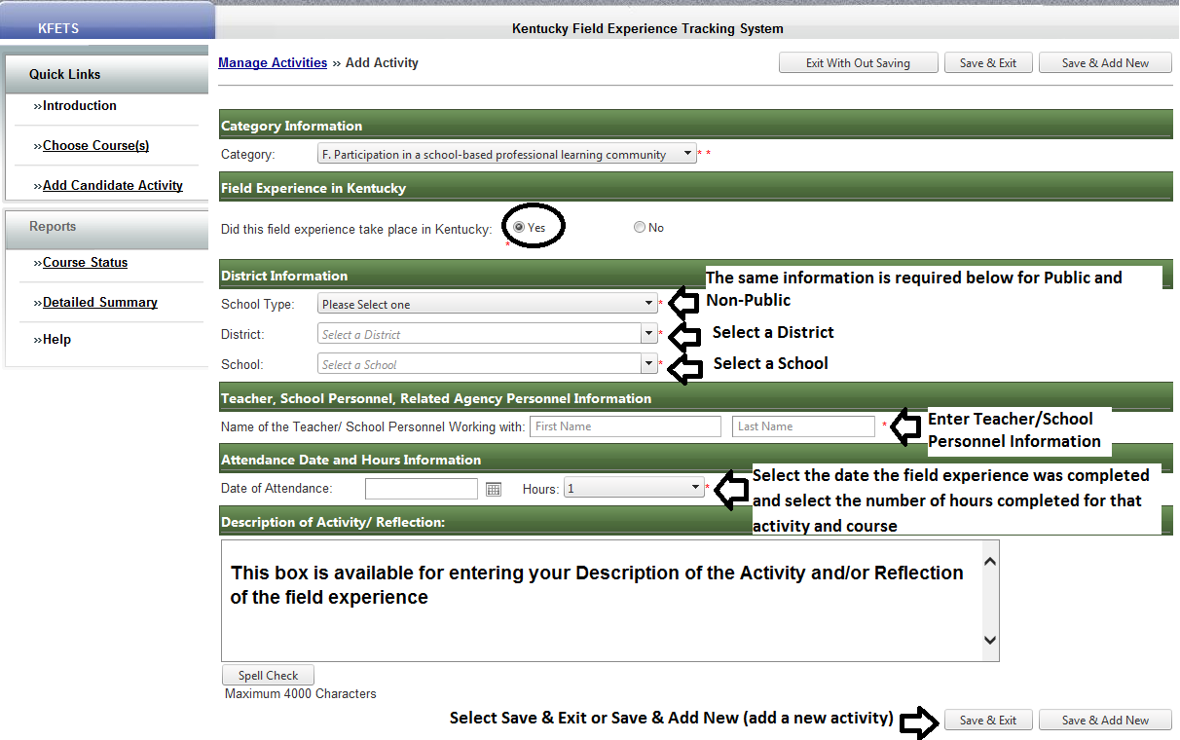
F. Participation in a school-based professional learning community
Kentucky/Public and Non-Public

Slide 32
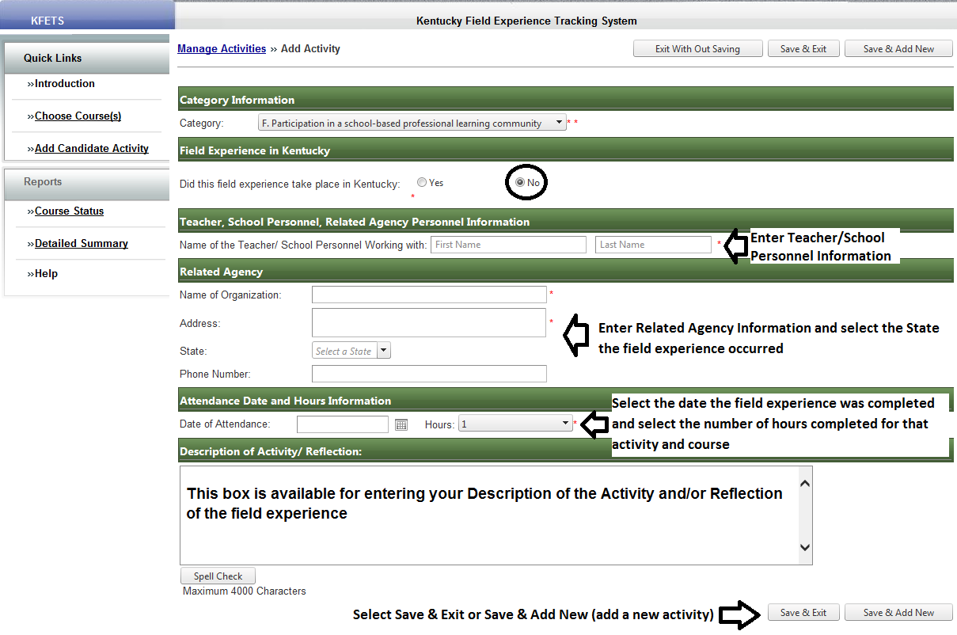
F. Participation in a school-based professional learning community
Out-of-state

Slide 33
G. Opportunities to assist teachers or other school professionals
Did this field experience take place in KY? Yes and Public
Select district information
Select teacher or school personnel information
Select date and enter hour(s) of field experience
Data from Infinite Campus will fill the diverse groups information (data prior to 2012 is not available)
Enter reflection
Did this field experience take place in KY? Yes and Non-Public
Select district information
Manually enter teacher/school personnel information
Select date and enter hour(s) of field experience
Manually select diverse groups information
Enter reflection
Did this field experience take place in KY? No
Manually enter teacher/school personnel information
Manually enter name of organization and related information
Select date and enter hour(s) of field experience
Manually select diverse groups information
Enter reflection

Slide 34
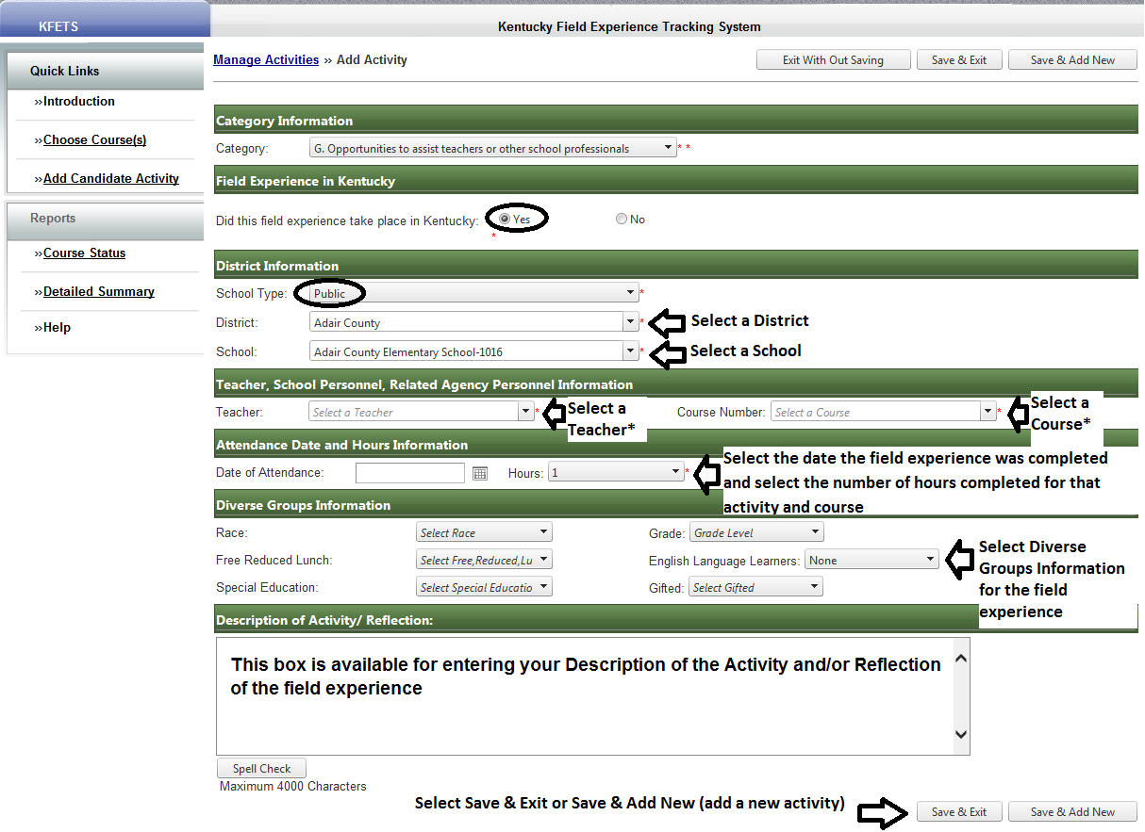
G. Opportunities to assist teachers or other school professionals
Kentucky/Public
If a teacher or course does not appear in the dropdown list, data for Diverse Groups Information will not appear. Choose “Other” at the bottom of the list of Teachers to manually enter data.

Slide 35
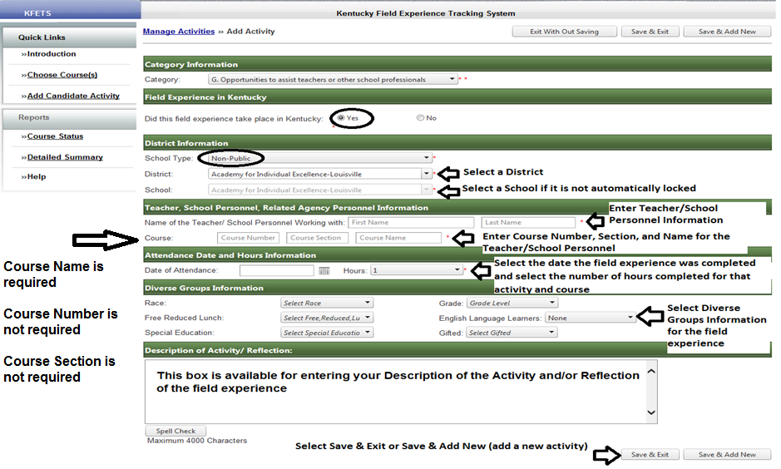
G. Opportunities to assist teachers or other school professionals
Kentucky/Non-Public

Slide 36
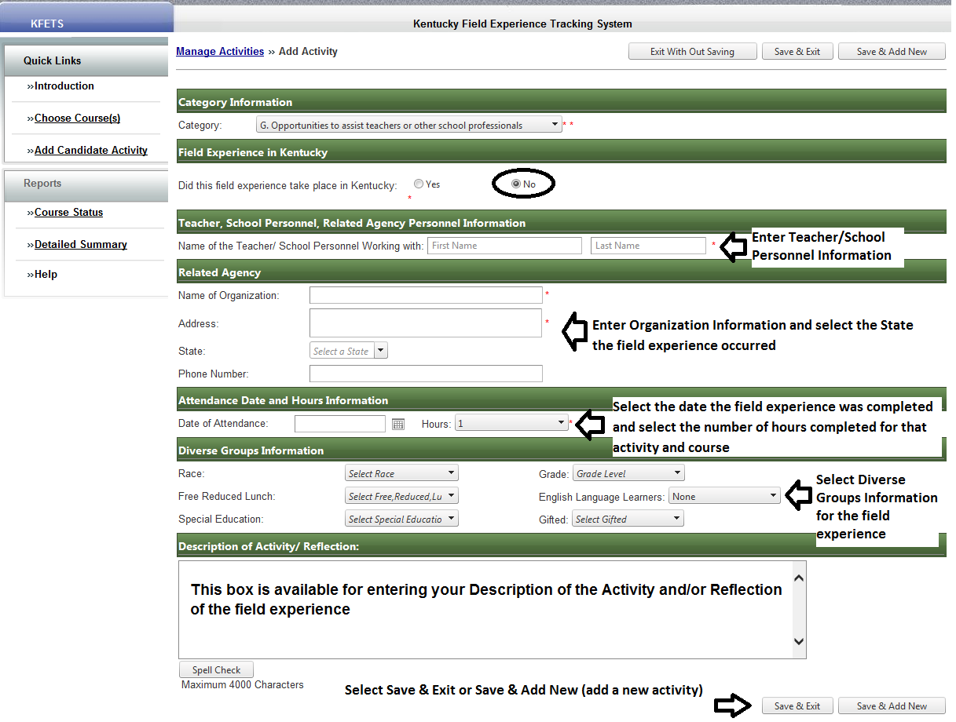
G. Opportunities to assist teachers or other school professionals
Out-of-state

Slide 37
Other
Category “H. Other” should be used for field experiences that do not fit any of the other categories. All information should be manually entered to identify and describe the activity.

Slide 38
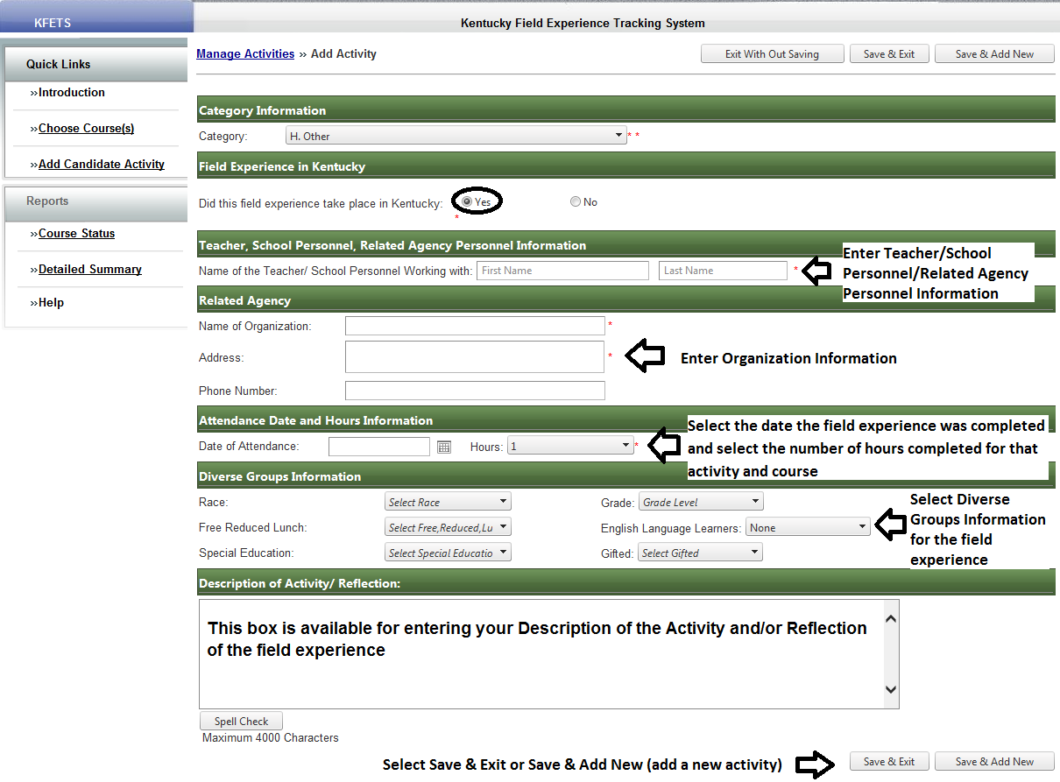
H. Other
Kentucky

Slide 39
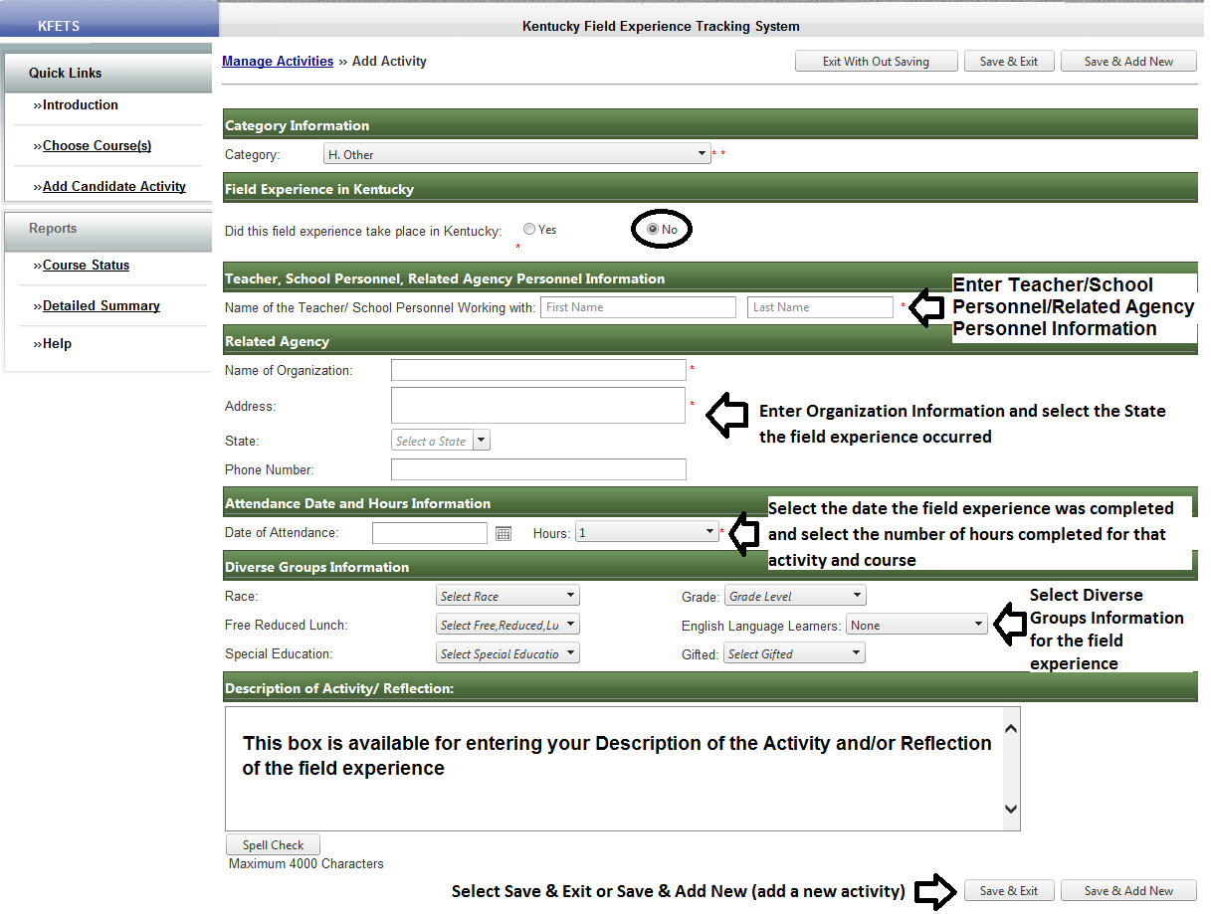
H. Other
Out-of-state

Slide 40
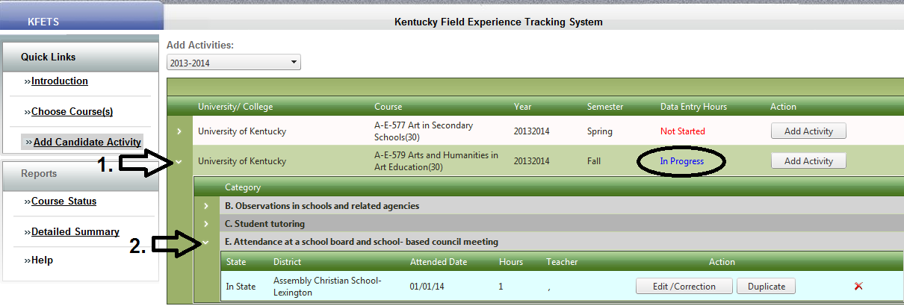
Add Candidate Activity
Activity details/ Edit and correct/ Duplicate
Click on arrow #1 to view the activities for the selected “In Progress” course. Click on arrow #2 to view details about the selected recorded activity. The activity may be edited/corrected by clicking the “Edit/Correction” button. The activity may be duplicated by clicking the “Duplicate” button. The activity may be deleted by clicking the red “X”.

Slide 41
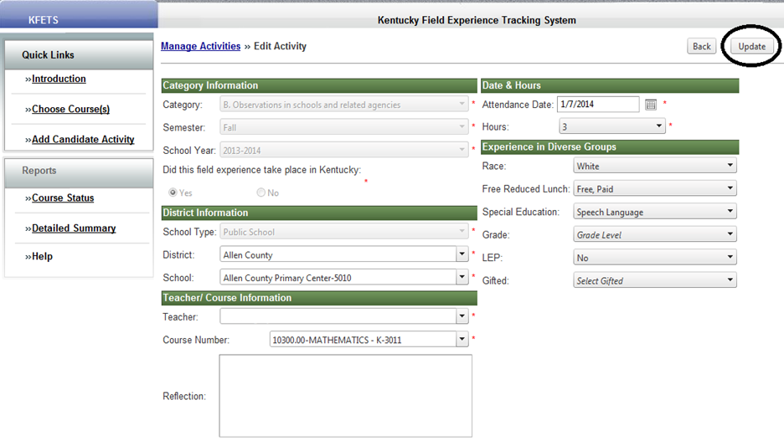
Add Candidate Activity
Edit/Correction
Once edits/corrections have been made, click the “Update” button on the upper right hand corner of the screen.

Slide 42
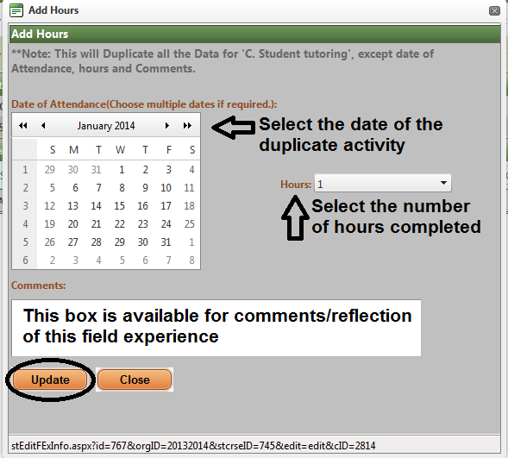
Add Candidate Activity
Duplicate activity
All field experience data will be duplicated except for the Date of Attendance, Hours, and Comments. Please be sure all other data should be duplicated before using this feature. Click “Update” to create a record of the field experience.

Slide 43
Course Status
This tab enables you to view the status of each course. “In Progress” means that activities have been added to that course.

Slide 44
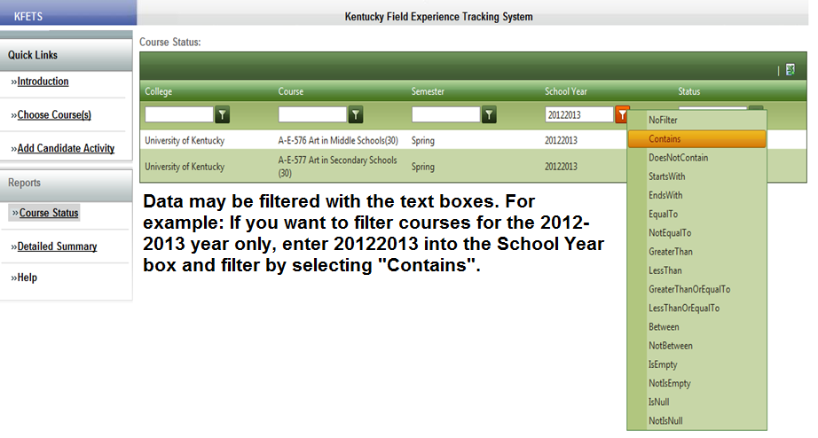
Course Status
Data may be filtered by College, Course, Semester, School Year, and/or Status.

Slide 45
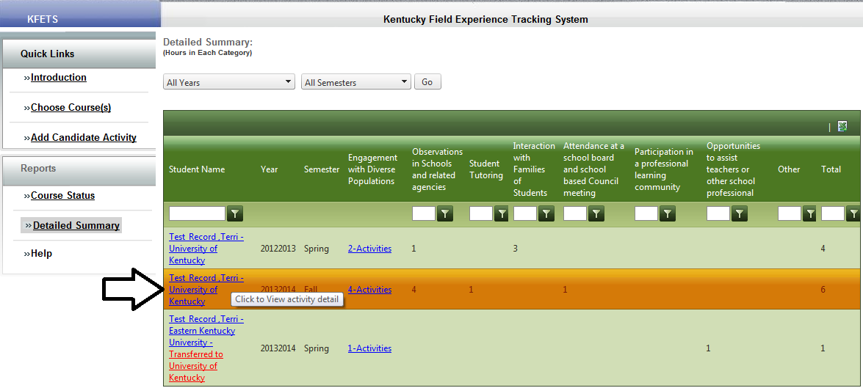
Detailed Summary
This tab will contain all activities and the hours recorded for each. Click on your name to view a breakdown of the course(s) and the category for each recorded activity.

Slide 46
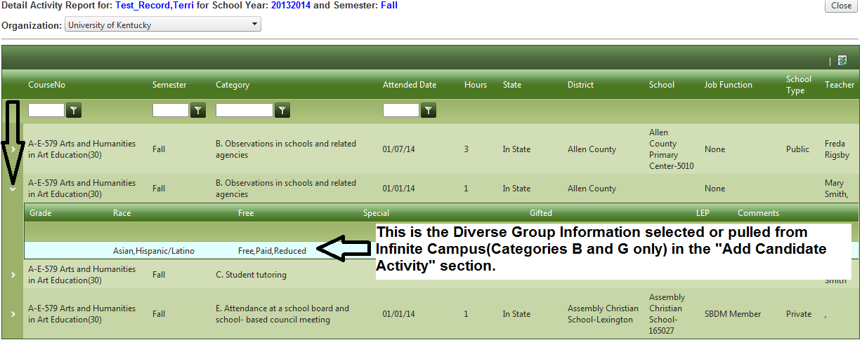
Detailed Summary
Click on the arrow next to the course name to view demographics for that particular activity.

Slide 47
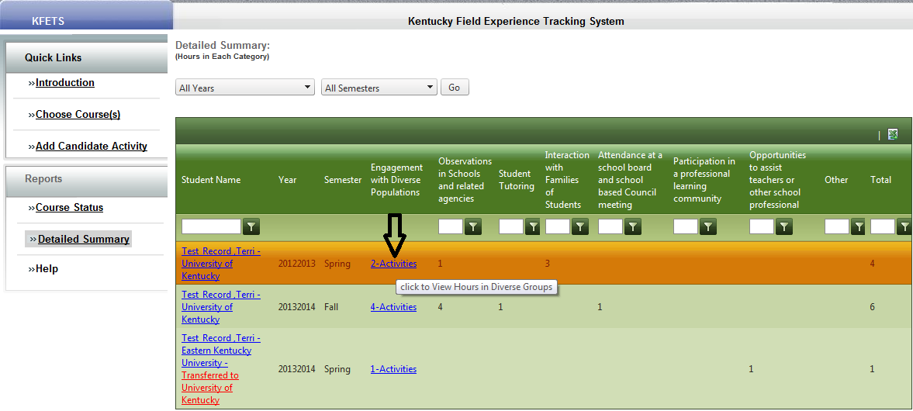
Detailed Summary
Click on the activities under “Engagement with Diverse Populations” to view details about the recorded hours. This shows the breakdown of the hour(s) for that one activity.

Slide 48
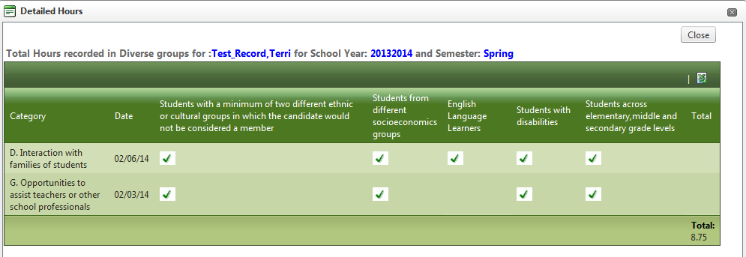
Detailed Summary
This box shows the breakdown of the diverse group information for the selected number of activities and hours.
The checked boxes indicate the interactions with Diverse Groups within that field experience.

Slide 49
Exporting Data
Data may be exported to Excel from each of the following sections
Choose Course: Export course information to Excel by clicking the Excel icon
Course Status: Export course status information to Excel by clicking the Excel icon
Detailed Summary: Export activity summaries to Excel by clicking the Excel icon

