Slide 1
Val-Ed 360°
Review & Alignment

Slide 2
Val-Ed 360° Review
The VAL-ED is a paper and on-line assessment which utilizes a multi-rater, evidence-based approach to measure the effectiveness of school leadership behaviors known to influence teacher performance and student learning.
The VAL-ED measures core components and key processes.
Core components refer to characteristics of schools that support the learning of students and enhance the ability of teachers to teach.
Key processes refer to how leaders create those core components.

Slide 3
Val-Ed 360° Components/Processes
 | Key Processes
 | Planning | Implementing | Supporting | Advocating | Communicating | Monitoring
Core Components
High Standards for Student Learning
Rigorous Curriculum
Quality Instruction
Culture of Learning and Professional Behavior
Connections to External Communities
Performance Accountability
The VAL-ED assesses the intersection of what principals must accomplish to improve academic and social learning for all students (the core components), and how they create those core components (the key processes).

Slide 4
Val-Ed 360°
Teachers 33.333
Principal 33.333
Supervisor(s) 33.333
RESULTS
Norm and standards-referenced profiles with suggested clusters of behaviors for improvement

Slide 5
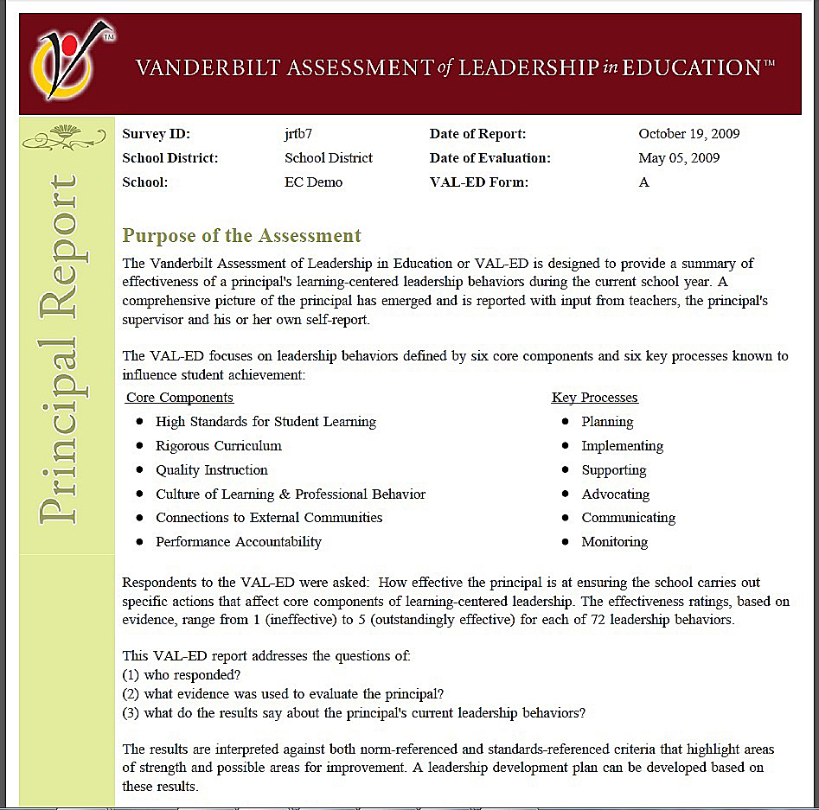
Val-Ed 360° Report

Slide 6
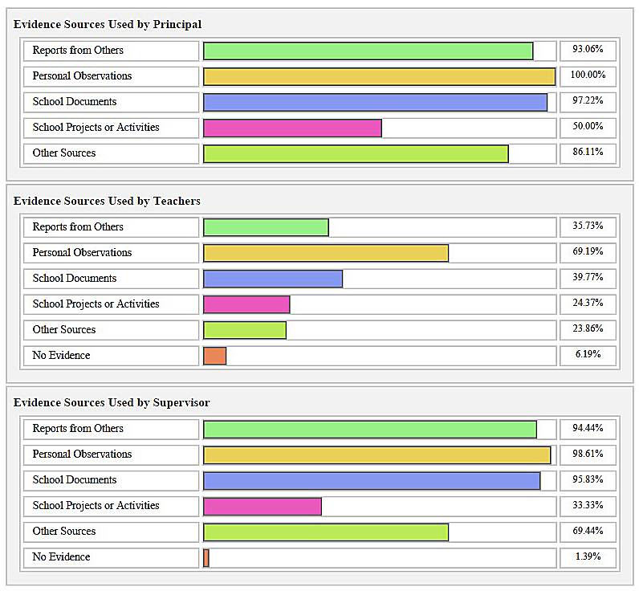
Val-Ed 360° Sources of Evidence

Slide 7
Val-Ed 360° Score
The 3.79 Mean Overall Effectiveness Score translates to a national percentile rank just above 70..
The principal’s Mean Overall Effectiveness Score based on the average across all 3 respondent groups was 3.79 and translates to the Proficient Performance Level.
COMPARISON BY VAL-ED PROFICIENCY STANDARDS
COMPARISON BY NATIONAL NORMS

Slide 8
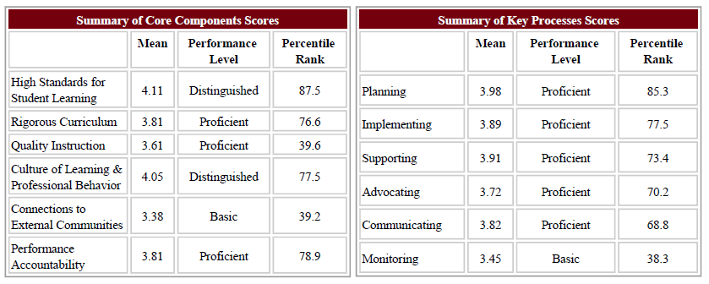
Val-Ed 360° Score

Slide 9
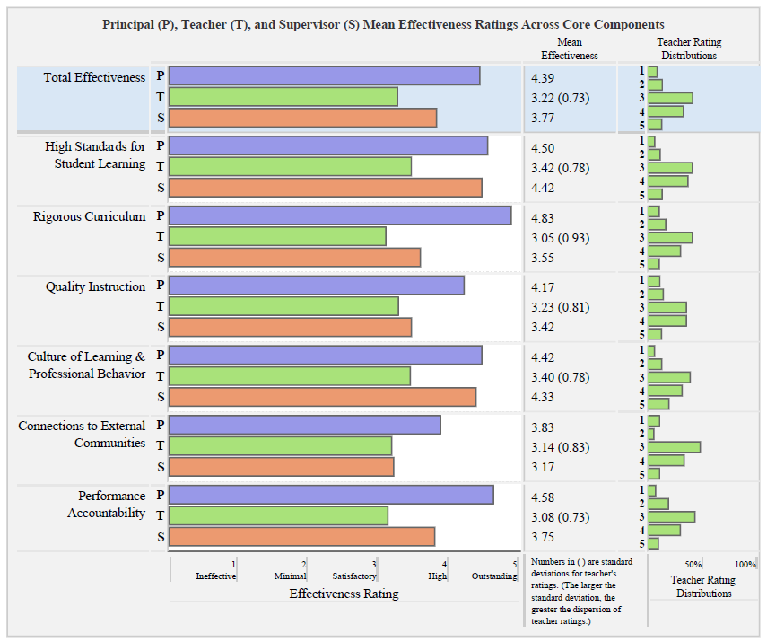
Val-Ed 360° Results-Components
5 point effectiveness rating
1 = ineffective
2 = minimally effective
3 = satisfactorily effective
4 = highly effective
5 = outstandingly effective

Slide 10
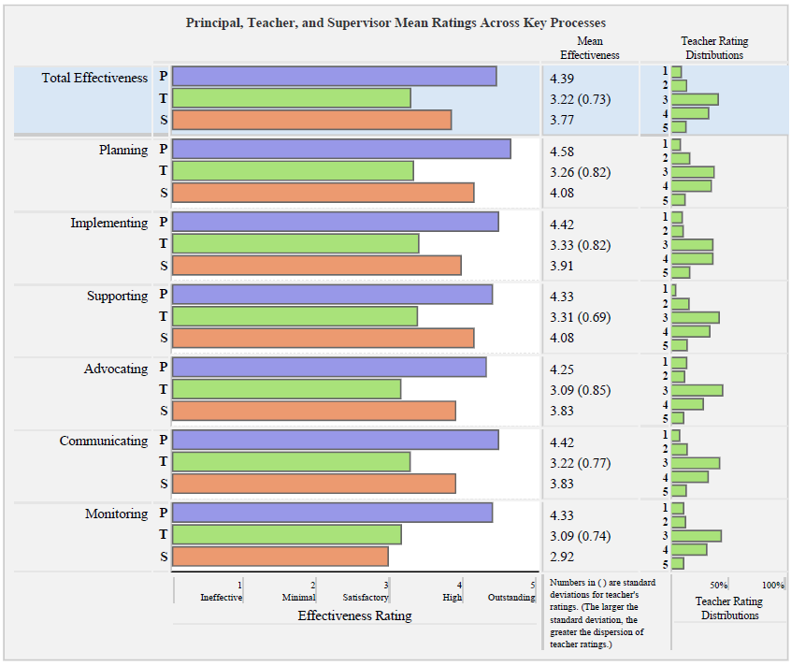
Val-Ed 360° Results-Key Processes
5 point effectiveness rating
1 = ineffective
2 = minimally effective
3 = satisfactorily effective
4 = highly effective
5 = outstandingly effective

Slide 11
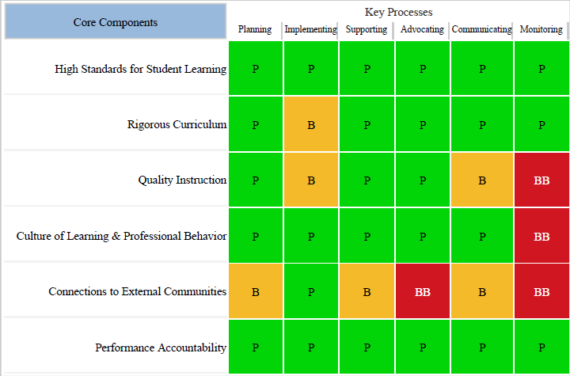
Val-Ed 360° Results-Key Processes

Slide 12
Val-Ed 360° & PPGES Standards
 | Planning | Implementing | Supporting | Advocating | Communicating | Monitoring
High standards for student learning | Instructional Leadership | Instructional Leadership | Instructional Leadership | Instructional Leadership | Communication & Community Relations | Student Growth
Rigorous Curriculum | Instructional Leadership | Instructional Leadership | Instructional Leadership | Instructional Leadership | Communication & Community Relations | Student Growth
Quality Instruction | Instructional Leadership | Instructional Leadership | Human Relations Management/ Organizational Management | Human Relations Management/ Organizational Management | Communication & Community Relations | Student Growth
Culture of Learning & Professional Behavior | School Climate/ Professionalism | School Climate/ Professionalism | School Climate/ Professionalism | Communication & Community Relations | Communication & Community Relations | School Climate/ Professionalism
Connections to External Communities | Communication & Community Relations | Communication & Community Relations | Communication & Community Relations | Communication & Community Relations | Communication & Community Relations | Communication & Community Relations
Performance Accountability | Human Relations Management | Human Relations Management | Human Relations Management | Human Relations Management | Communication & Community Relations | Student Growth

Slide 13
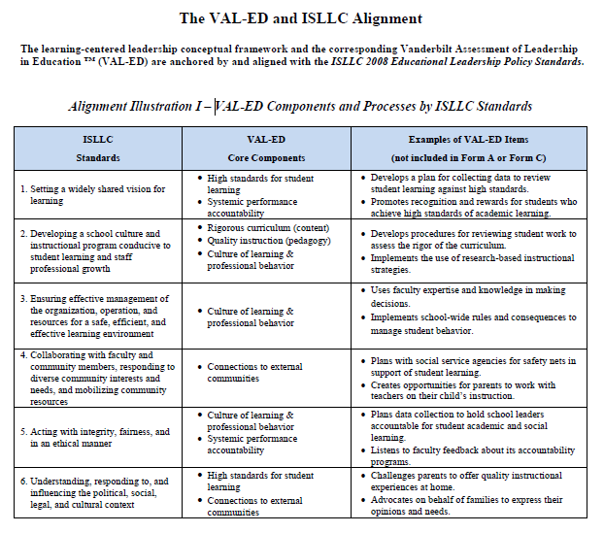
Val-Ed 360° & ISLLC Standards

Slide 14
Val-Ed 360° Webpage
www.valed.com

